Slide 1
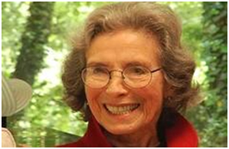
Sylvia Hyman 1917-2012
trompe l'oeil sculptures

Slide 2
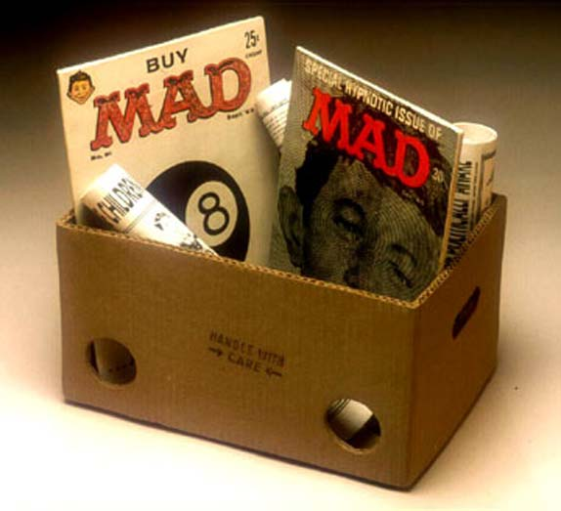
Sylvia Hyman, Buy Mad 25¢ Cheap - 2003, stoneware porcelain, 11 x 12 x 8 inches

Slide 3
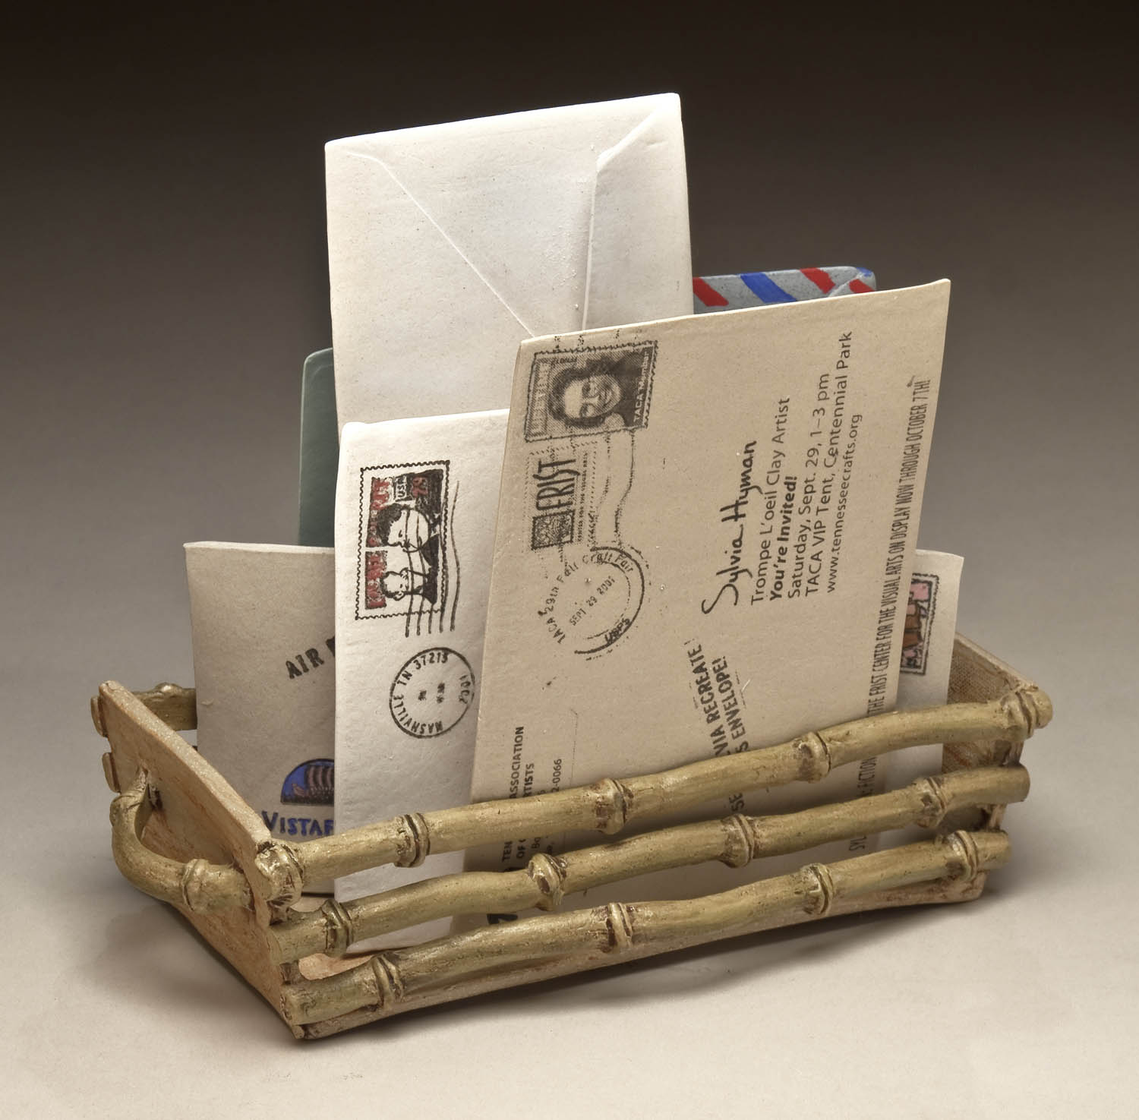

Slide 4
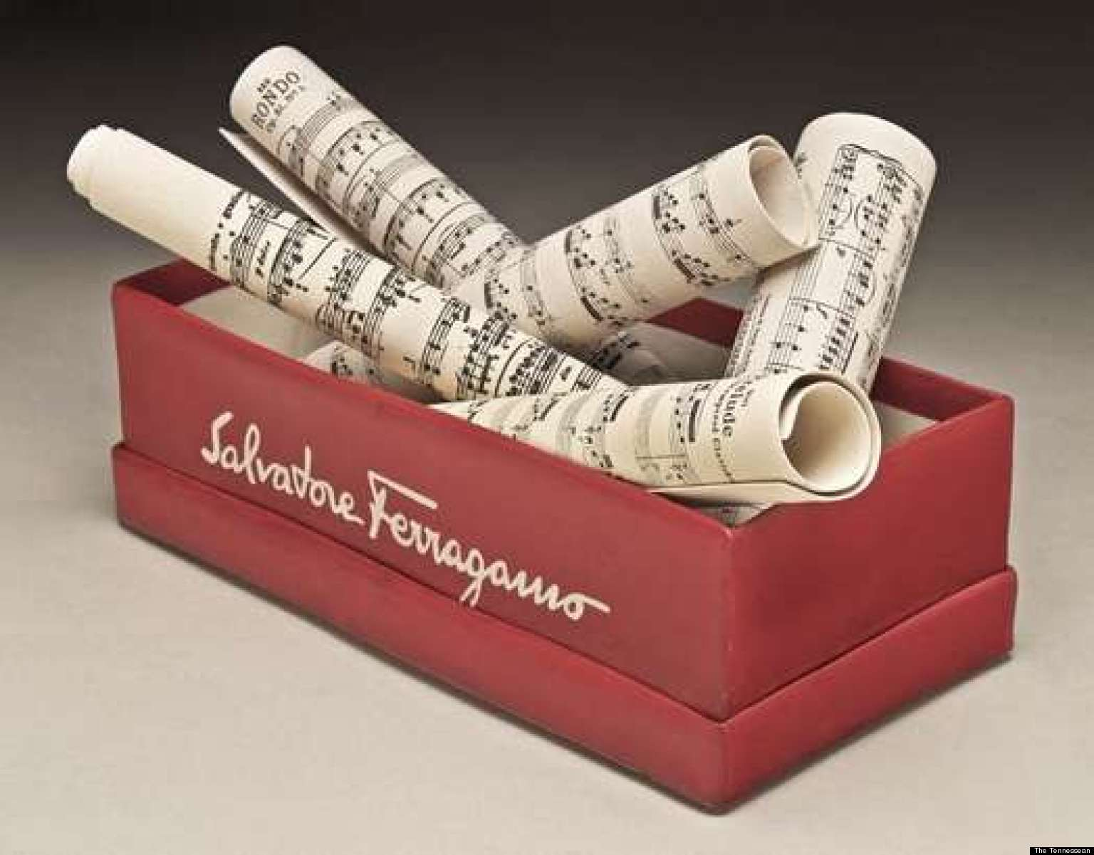

Slide 5
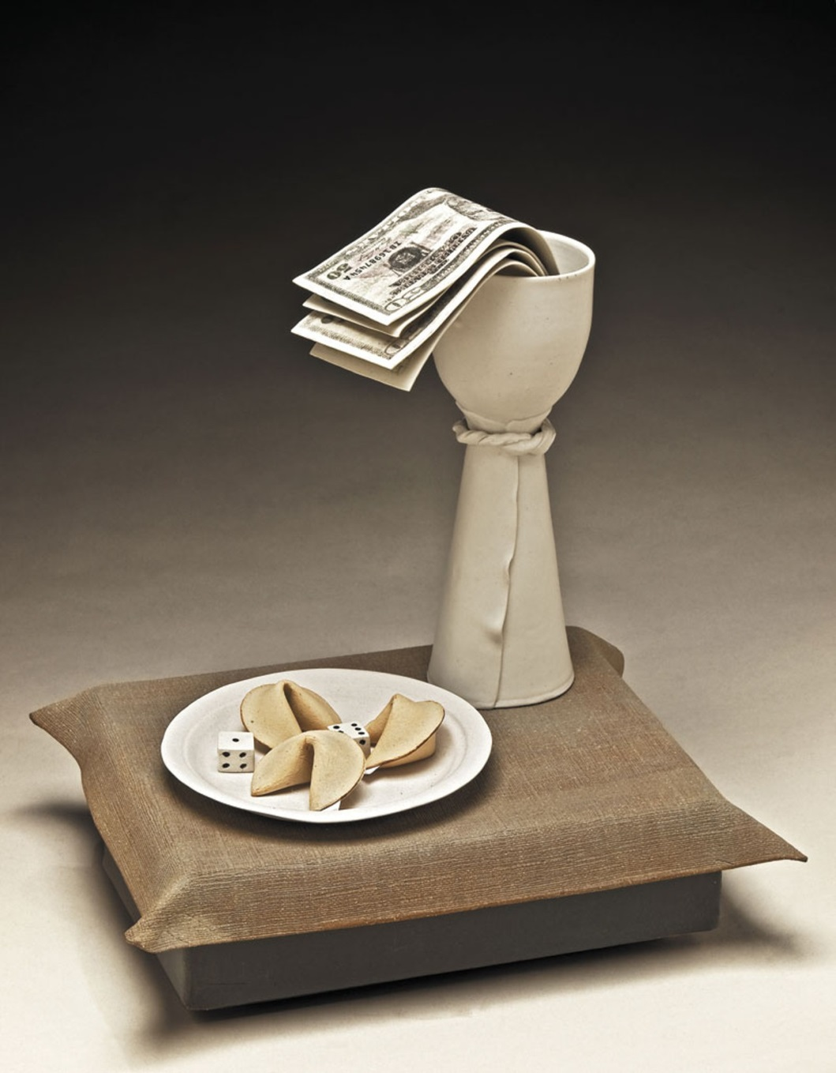

Slide 8
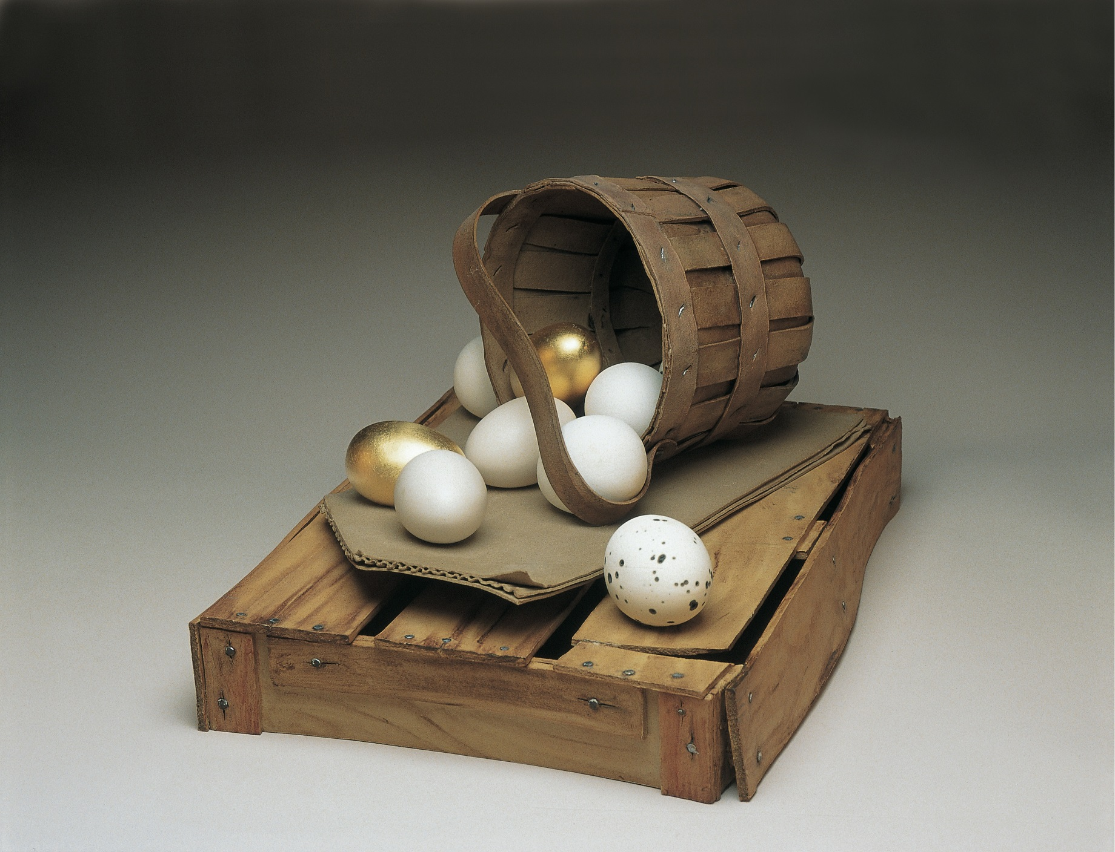

Slide 9
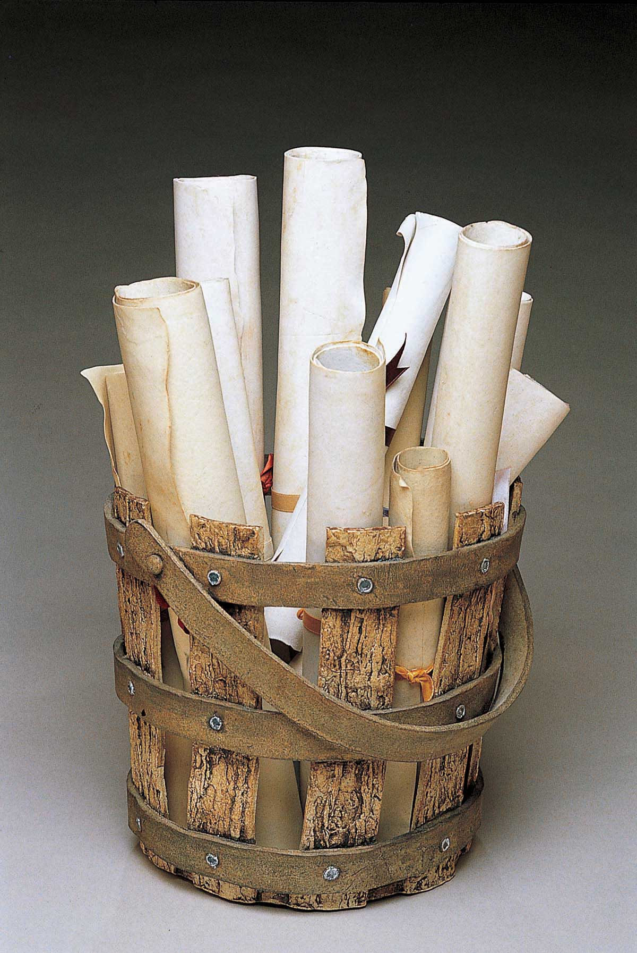

Slide 10
https://www.youtube.com/watch?v=URowxPJs5ZQ
https://www.youtube.com/watch?v=5lZ5VIB_v9M

Slide 11
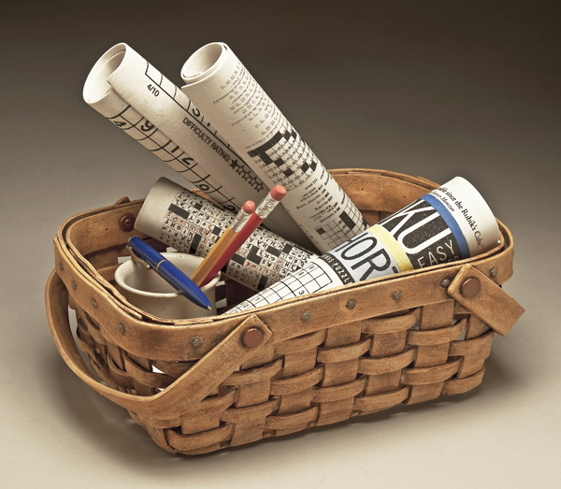

Slide 12
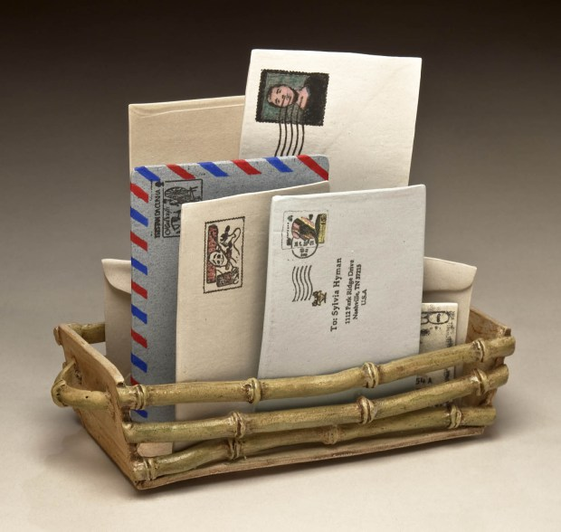

Slide 13
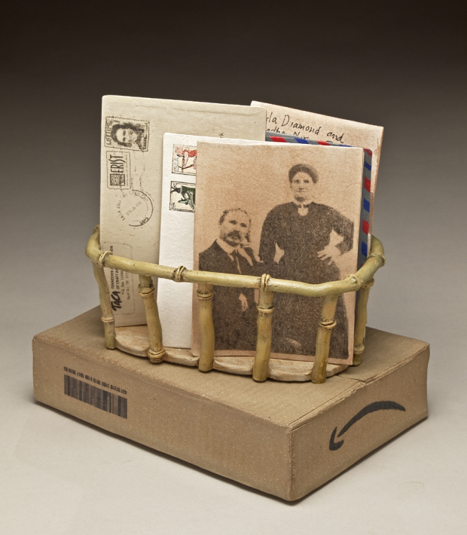

Slide 14
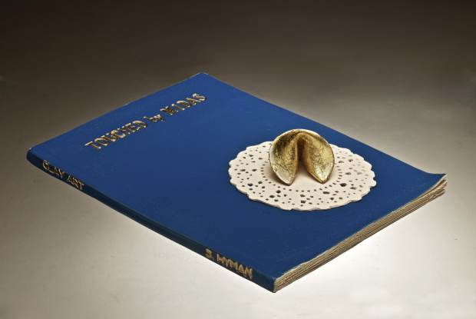

Slide 15
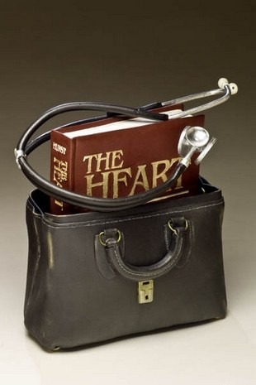
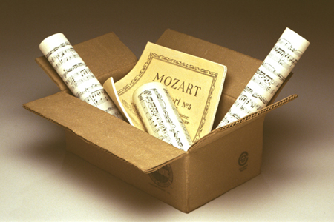

Slide 16
trompe l'oeil
List three items you would want to make in this style.

