Slide 1
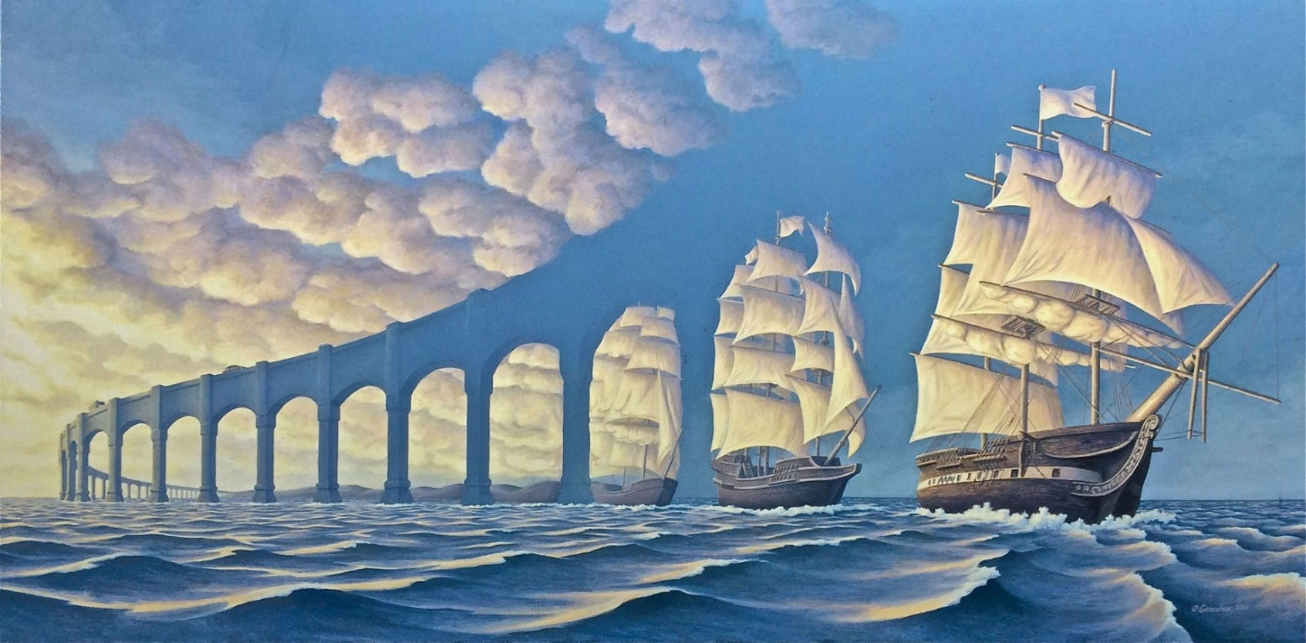
Surrealism
an avant-garde movement which started in 1920’s in art and literature that sought to release the creative potential of the unconscious mind, a dreamlike state

Slide 2
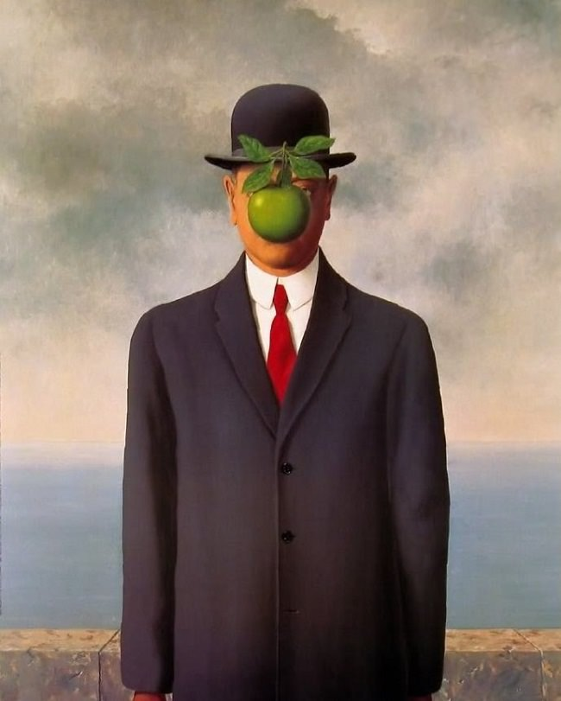
Draw

Slide 3
Surreal Artists
René Magritte (Belgium, 1898-1967)
1.
2.
3.
4.
5.

Slide 4
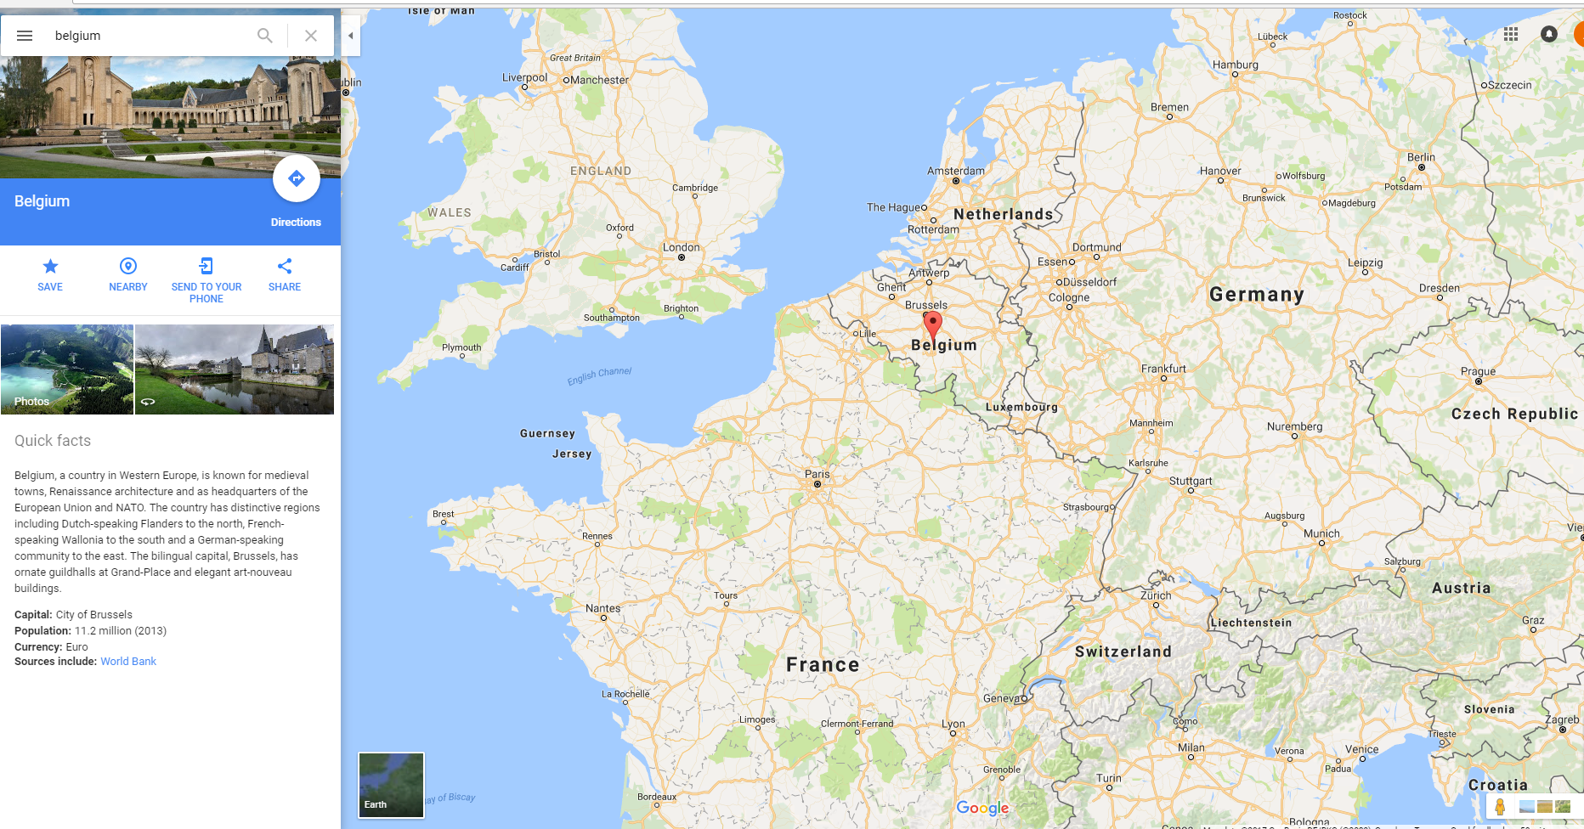

Slide 5
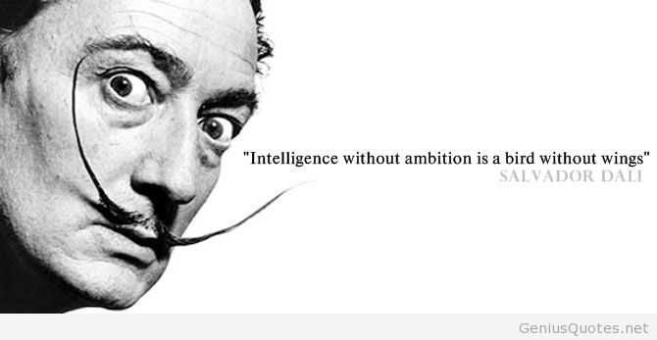
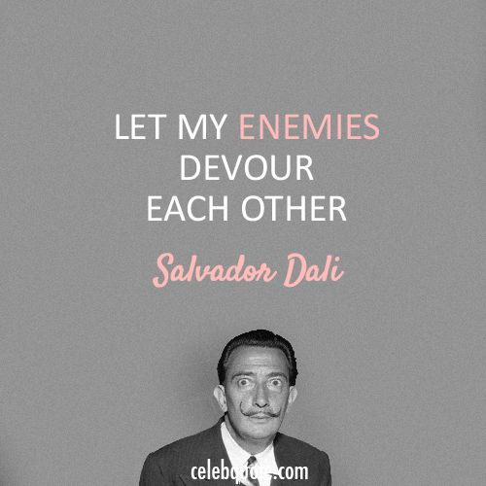
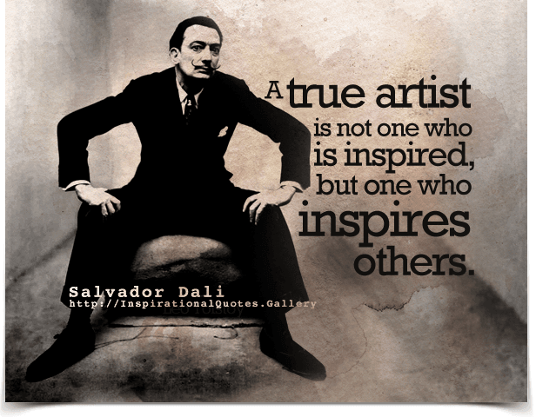

Slide 6
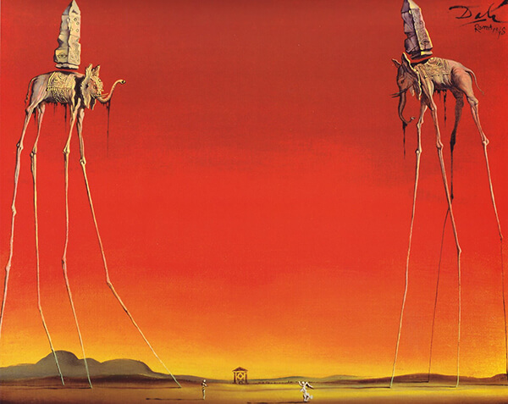

Slide 7
Surrealism
Salvador Dali (Spain, 1904-1989)
1.
2.
3.
4.
5.

Slide 8
Spellbound (1945) American psychological mystery thriller film
The Fault... is Not in Our Stars, But in Ourselves...
— William Shakespeare
Alfred Hitchcock & Salvadore Dali- Dream Sequence https://www.youtube.com/watch?v=JyPe1Jahyfo&index=8&list=PLeXYrbwGz0bk3rPtBCZT8qM-ooAdnxFQF

Slide 9
DALI vs. Magritte
Number 1-5

Slide 10
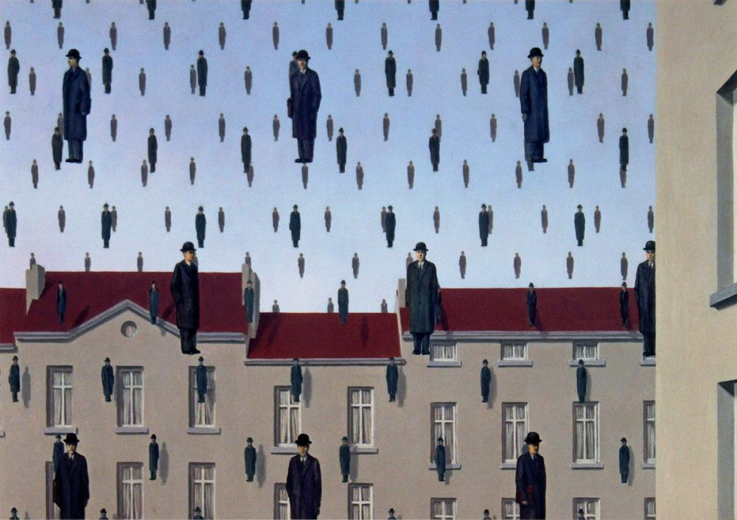

Slide 11
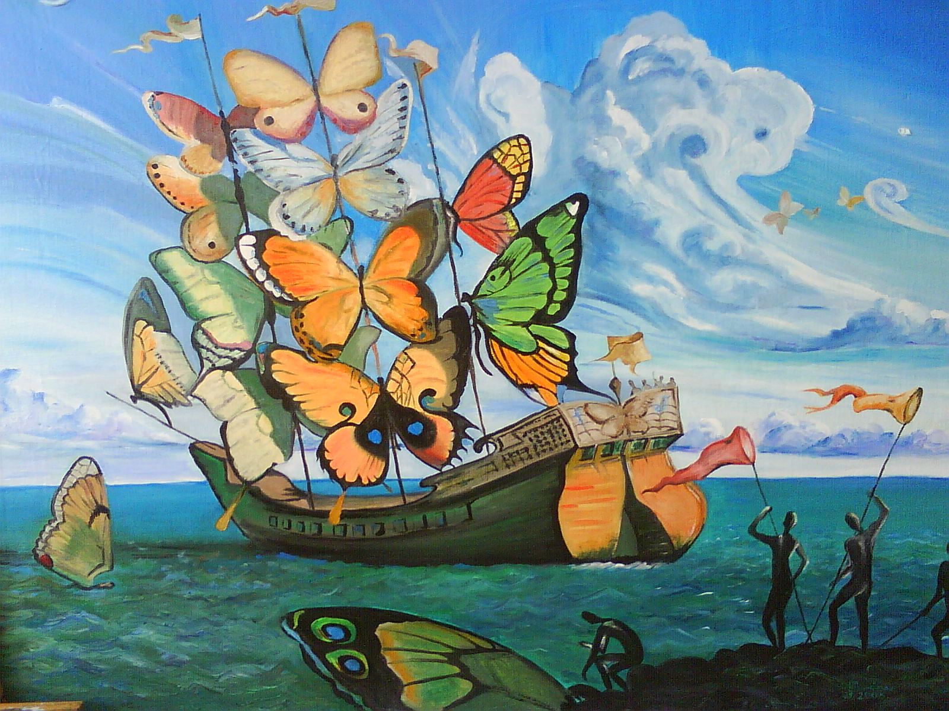

Slide 12
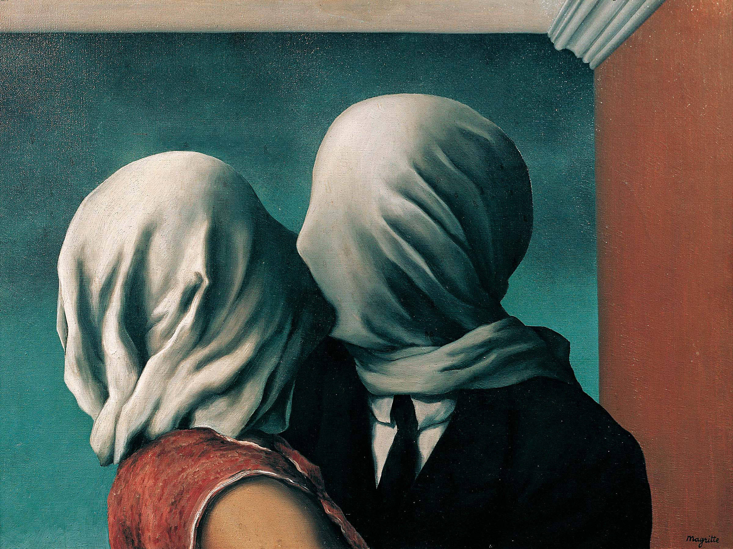

Slide 13
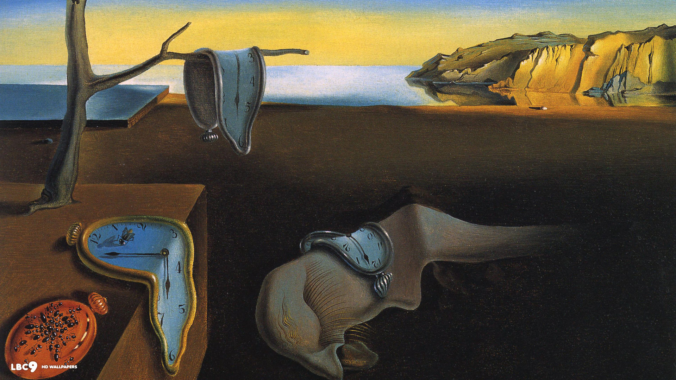

Slide 14
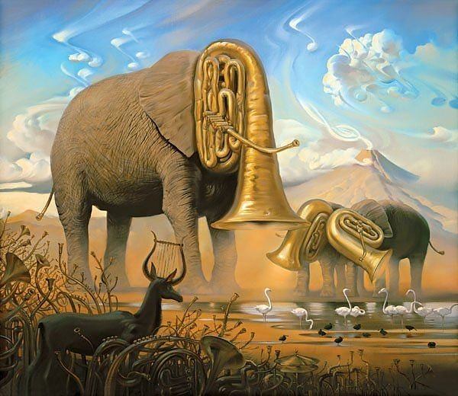

Slide 15
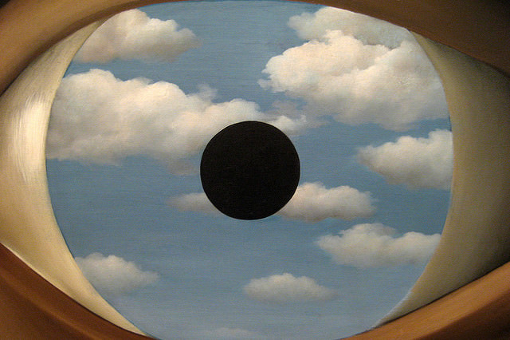

Slide 16
Number 1-12
Nouns
Person, place or thing

Slide 17
Landscapes
THE RULE OF THIRDS - is applied by aligning a subject with the guide lines and their intersection points.
1.placing the horizon on the top or bottom line
2. allowing linear features in the image to flow from section to section.

Slide 19
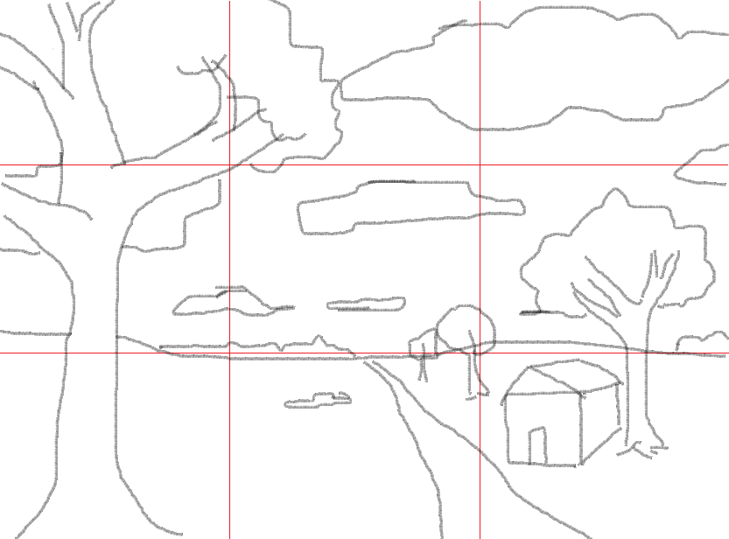
Rule of Thirds
Avoid placing important images in the center. It creates a bull’s-eye effect.
Large, close-up objects are usually positioned to the left or the right side of the picture.

Slide 20
Depth and Proportion in Landscapes
Foreground – objects closest to you should be drawn very large

Slide 21
Depth and Proportion in Landscapes
Middle ground –objects are smaller than foreground objects.
-Bottom of objects will be higher than Foreground.

Slide 22
Depth and Proportion in Landscapes
Background –objects should be drawn the smallest.
-Bottom of objects will be higher than middle ground objects.

Slide 23
Depth and Proportion in Landscapes
Sky/Clouds – clouds are larger at the top of the picture and will get smaller the closer they are to the horizon.

Slide 24
Depth and Proportion in Landscapes
Roads/paths/rivers –get smaller the closer they get to the horizon and larger the closer they get to the bottom of the picture.

Slide 25
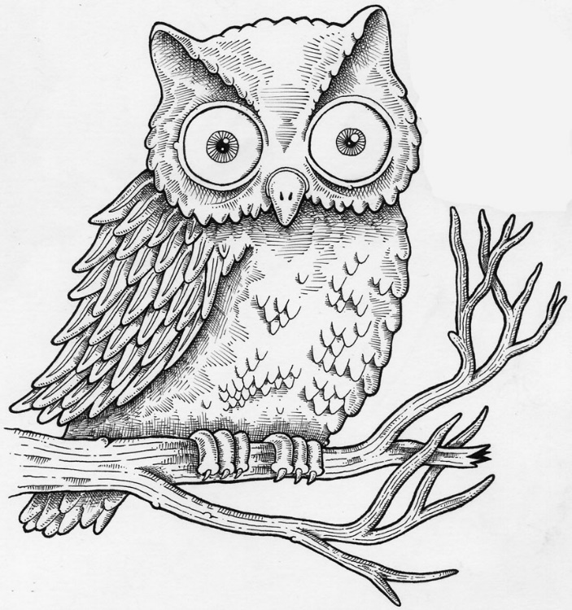
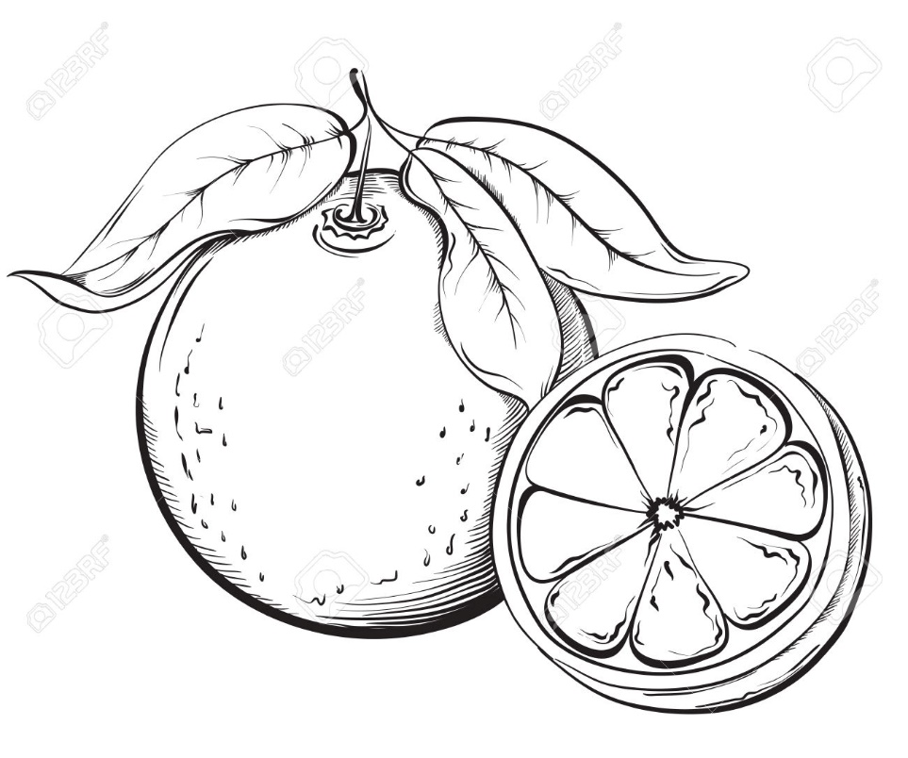
Draw 9 Nouns 2”-3” tall
Nouns
Person, place or thing

Slide 26
You will choose the type of landscape you would like for your painting.
You will be assigned a letter of the alphabet. Brainstorm 10 nouns/objects that start with that letter.
In your sketchbook draw a small picture of each noun or object.

