Slide 1
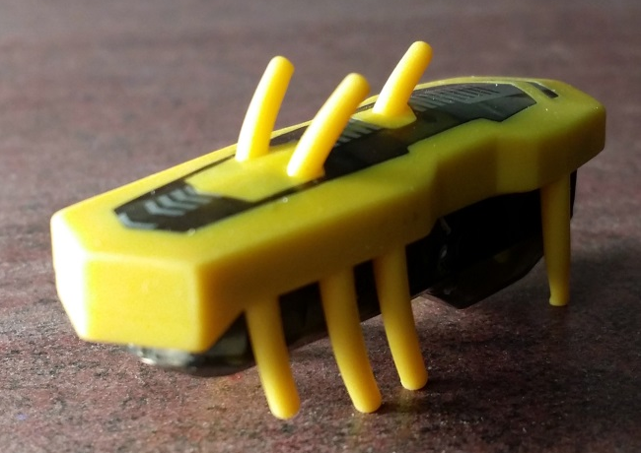
Shading Assessment
Accurately draw and shade this photo in the space below. 45 minutes
You will be graded on the following:
Accuracy of value 20 points
(min. of 5 values, #1 & #10)
Accuracy of drawing 20 points
Quality shading 20 points
(smooth, no gaps, no streaks)
Composition 20 points
(fills the square)
Craftsmanship 20 points
(No smudges, smears, or fingerprints)
__________%
Name:__________________________________ Period: __________

