Slide 1
Get out sketchbook
Printmaking Design
Printmaking Plate

Slide 2
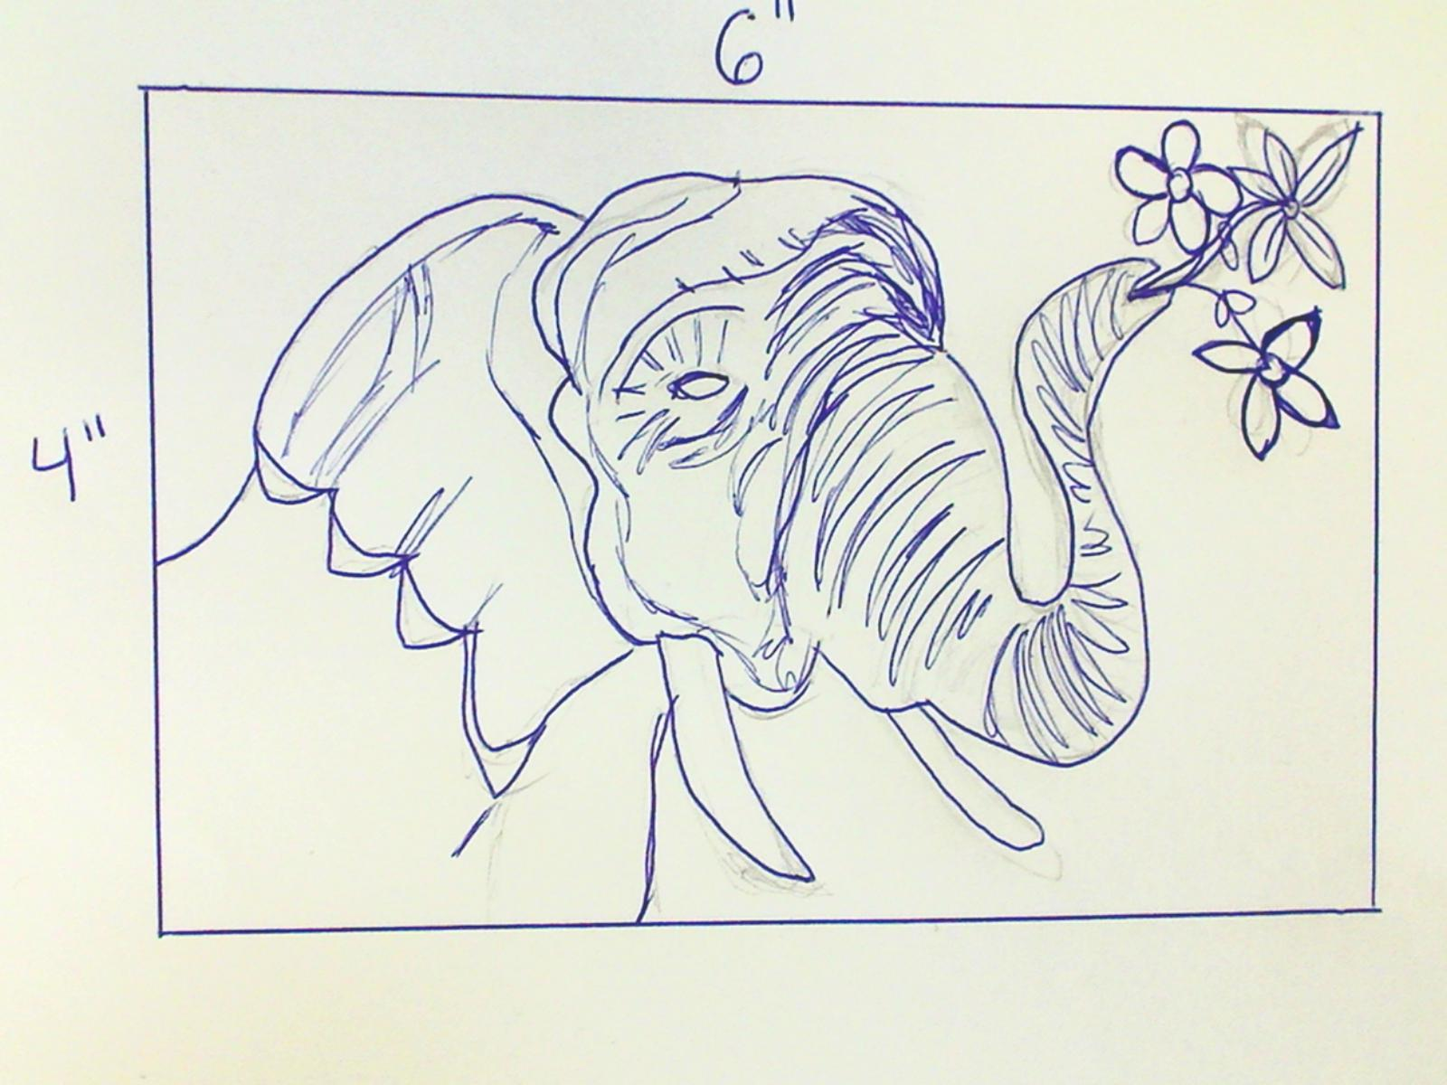
Step 1- Draw image

Slide 3
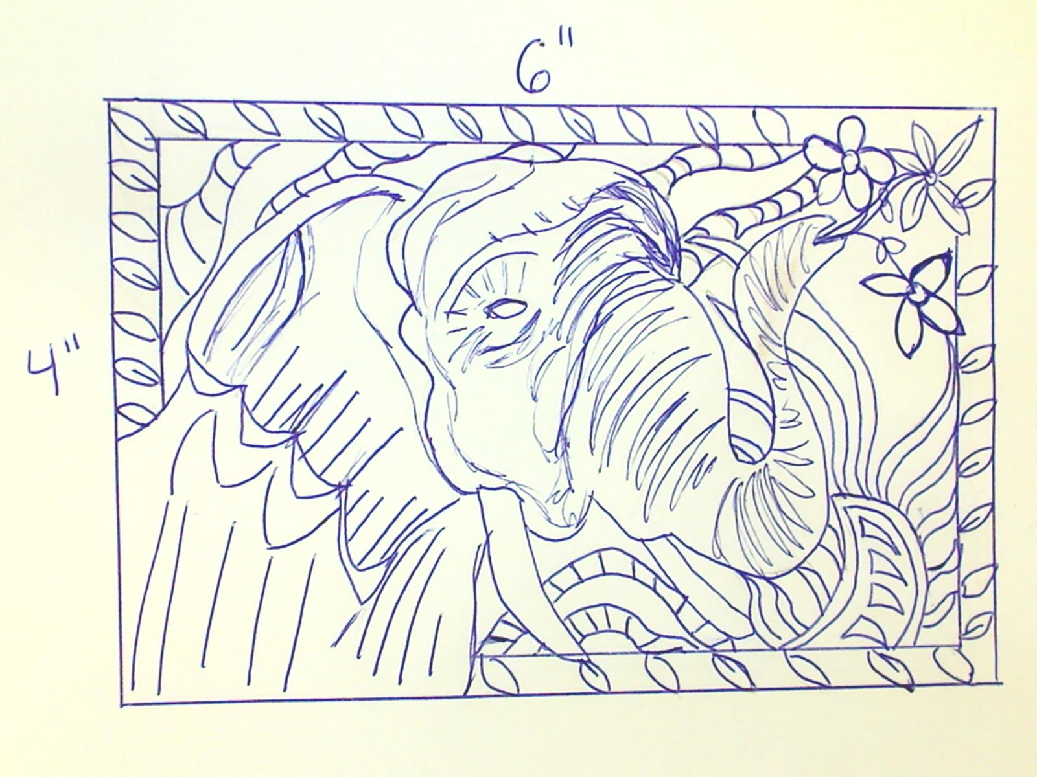
Step 2: Fill the background. No empty Space!

Slide 4
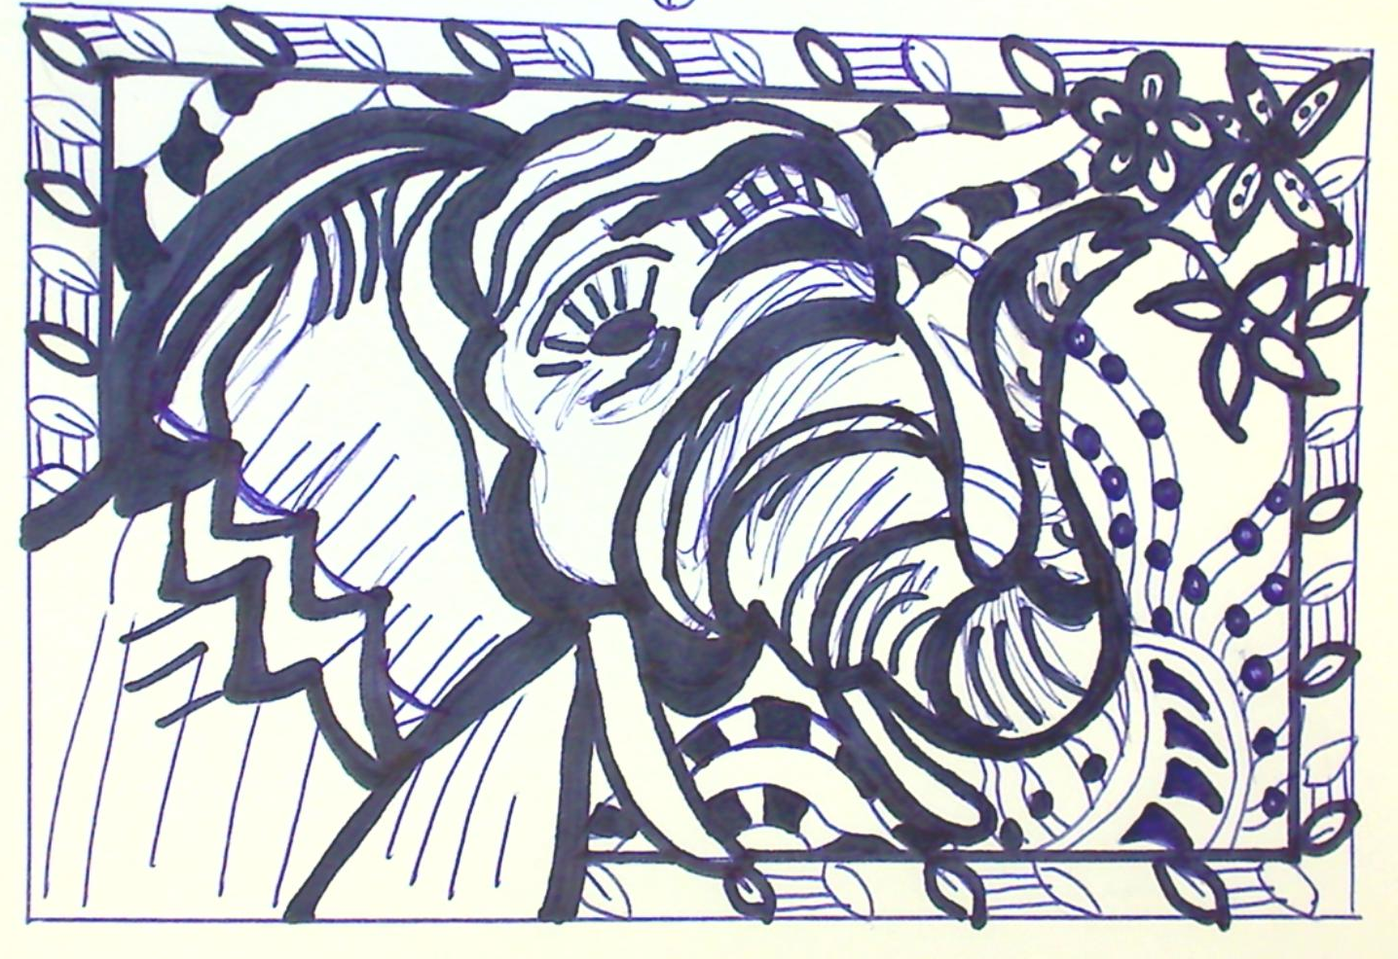
Step 3- Add thick lines, color in spaces.

Slide 5
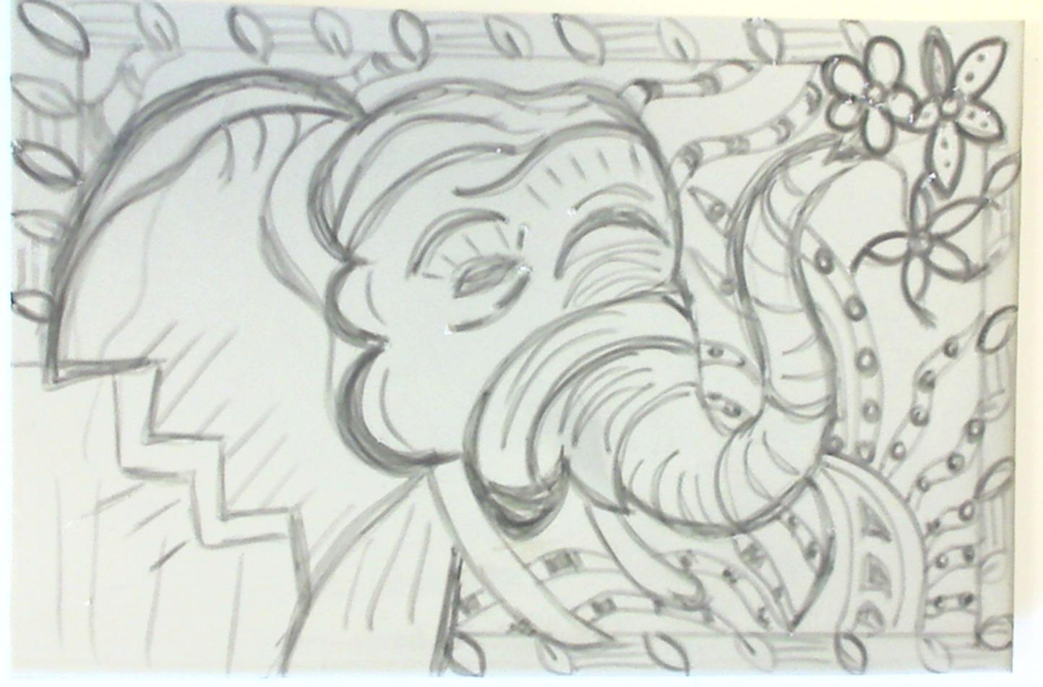
Step 4- Draw on plate

Slide 6
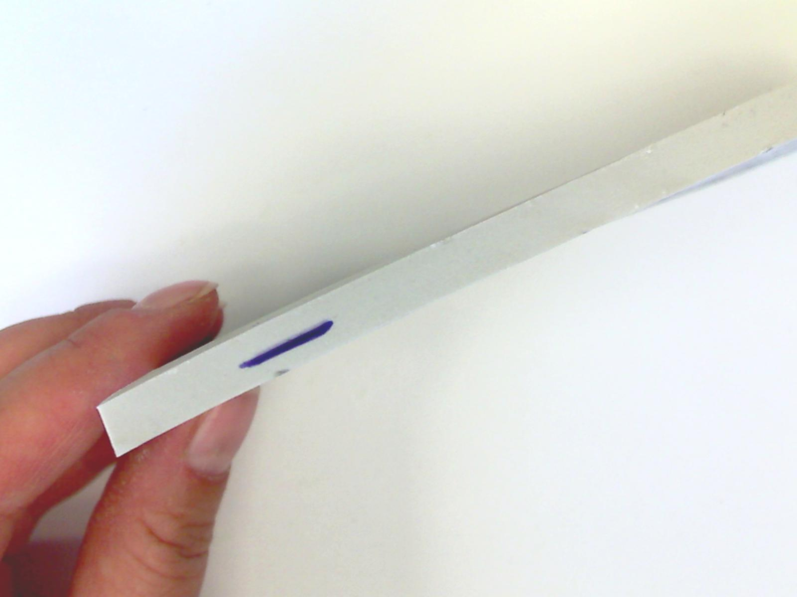
Do not carve deep

Slide 8
DO NOT CARVE
PENCIL LINES!!!

