Slide 1
Kush vs. Magritte

Slide 2
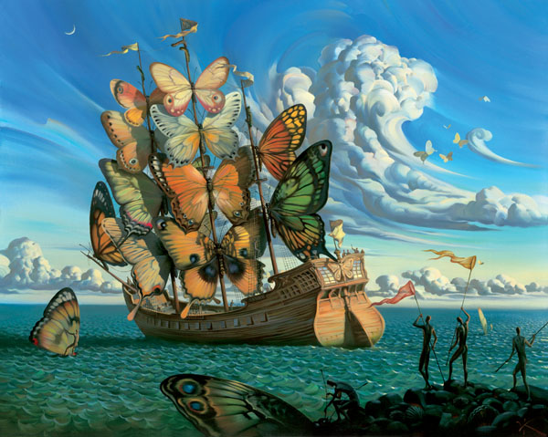
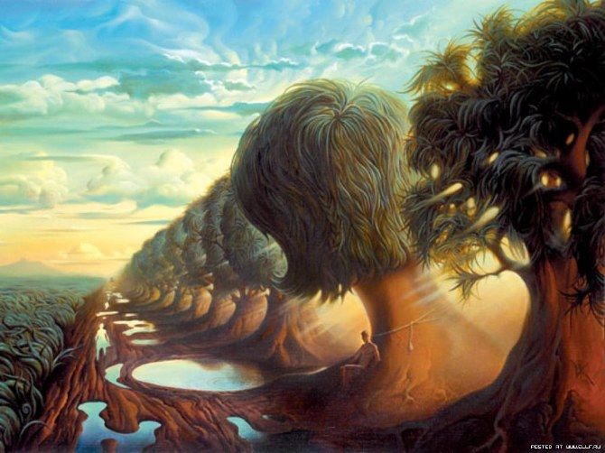
Vladimir Kush
Born in Moscow, Russia
age of 7 he began to attend art school until late evening
Vladimir entered the Moscow Higher Art and Craft School at age 17.
At 18 he was conscripted(drafted). After six months of military training the unit commander thought it more appropriate to employ him exclusively for peaceful purposes, namely, painting propagandistic posters.
After military service and graduating the Institute of Fine Arts, Vladimir painted portraits to support his family during the hard times in Russia.

Slide 3
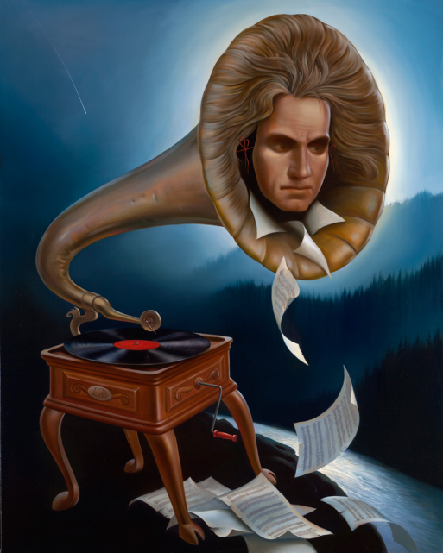
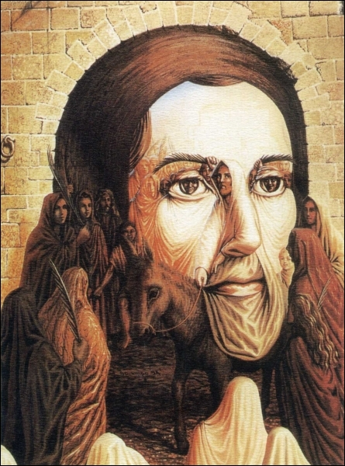
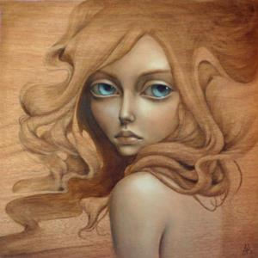
1987-Vladimir began to take part in exhibitions organized by the Union of Artists.
1990-Coburg, Germany nearly all his displayed paintings sold and after closing the exhibition
In Los Angeles, Kush worked in a small, rented home garage, but was unable to find a place to display his paintings.
He earned money by drawing portraits on the Santa Monica pier and eventually moved to Hawaii.

Slide 4
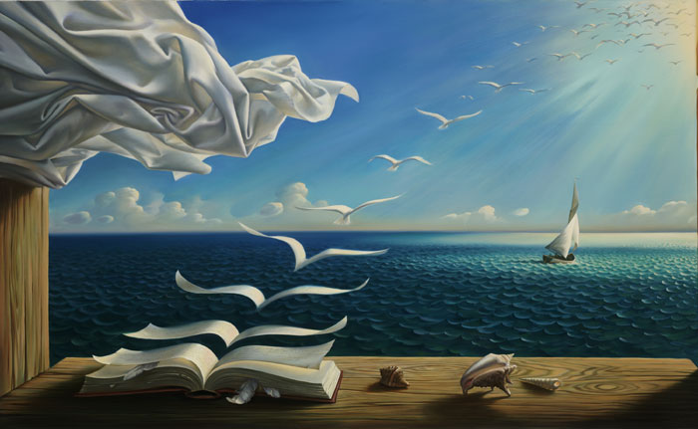
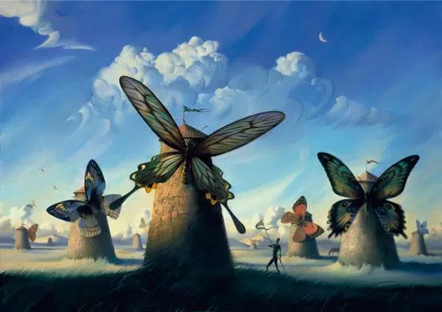
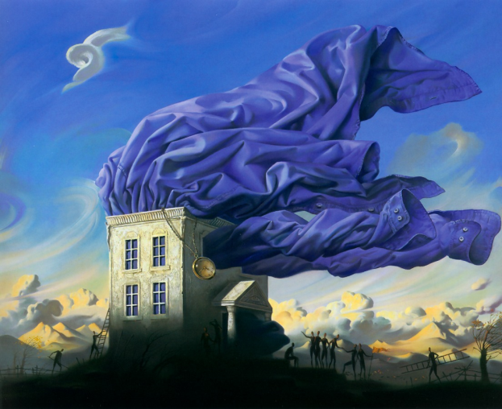
1993- a dealer from France noticed the originality of Kush’s work and organized an exhibition in Hong Kong.
1997- he exhibited in the galleries in Lahaina, Hawaii and in Seattle.

Slide 5
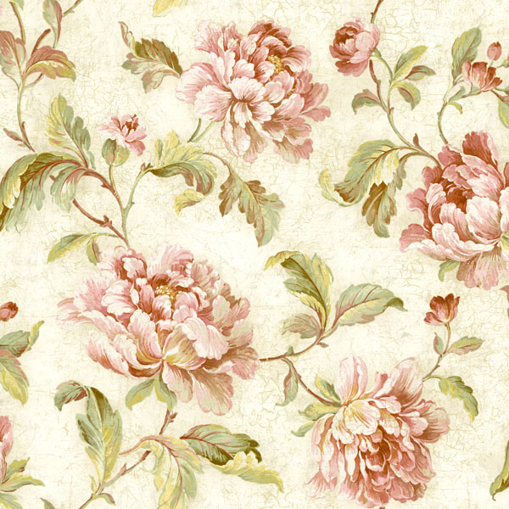
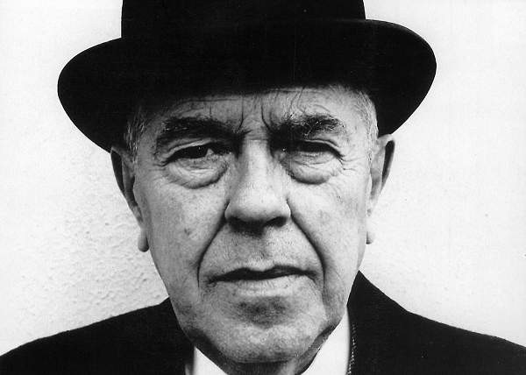
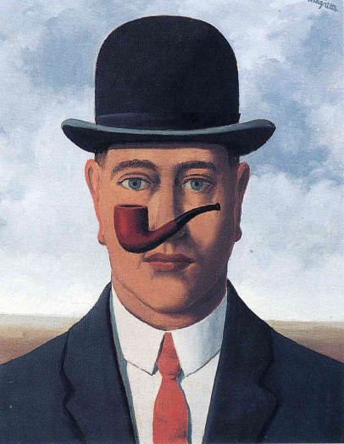
Rene Magritte
Born in 1898
Internationally acclaimed surrealist artist
1916 -1918 study at the Academie des Beaux-Art in Brussels.
"My painting is visible images which conceal nothing; they evoke mystery and, indeed, when one sees one of my pictures, one asks oneself this simple question, 'What does that mean?' It does not mean anything, because mystery means nothing, it is unknowable."
He left the school, because he thought that it was a waste of time
1922 he married Georgette, and took a number of small jobs, including painting cabbage roses for a wallpaper company, to pay the bills.
He reached fame in his 50’s.

Slide 6
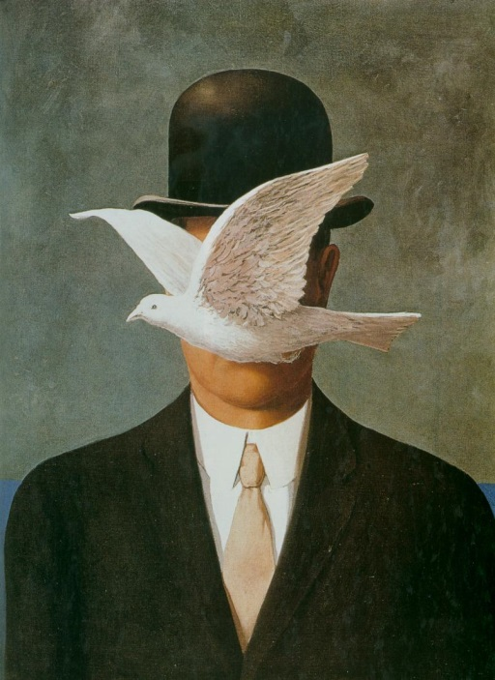
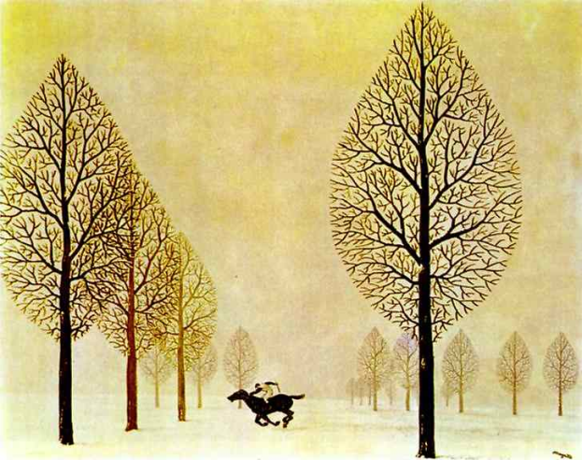
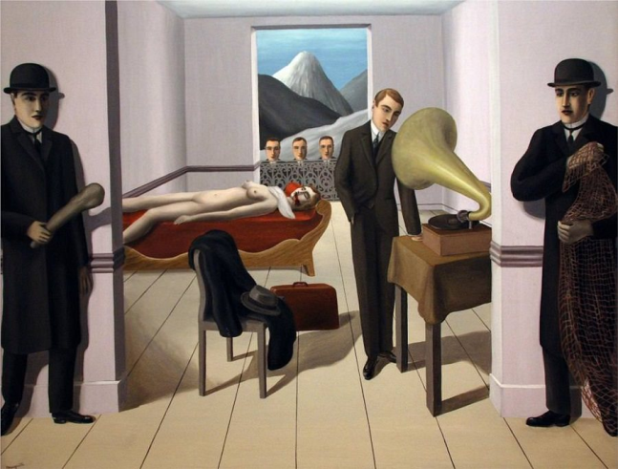
Early in his career Magritte realized surrealism was the art form he most enjoyed.
1925 The Lost Jockey
1926- The Threatened Assassin was one of his earliest pieces
1927-Magritte had his first one man show in Brussels.
During this period of his life, he was producing nearly one piece of art work each day. Critiques did not like his work.
Depressed by failure, he moved to Paris and became friends with artist Andre Breton, the founder of Surrealism.
1927-1930, Rene Magritte became actively involved in the surrealist group, and much of the works during this time period were described as cavernous, showcasing bizarre scenes

Slide 7
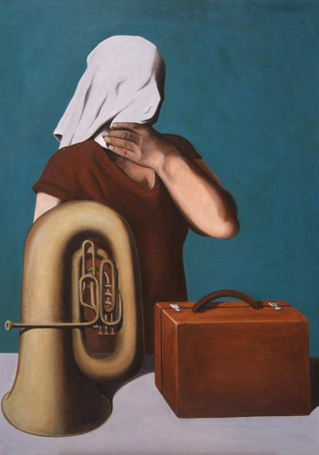
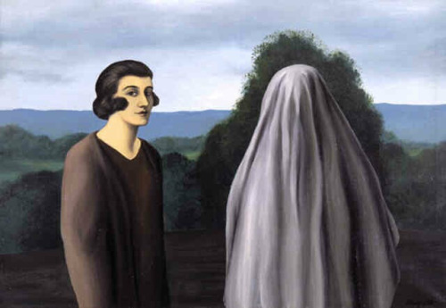
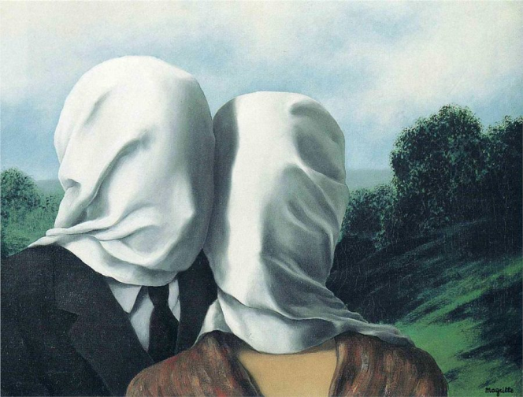
To Magritte, what is concealed is more important than what is open to view
This was true both of his own fears and of his manner of depicting the mysterious
If he wrapped a body in linen it was not so much to hide as to achieve an effect of alienation.
“Everything we see hides another thing, we always want to see what is hidden by what we see. ” – Rene Magritte
During the German occupation of Belgium in World War II, Magritte remained in Brussels. After the fallout with Breton, Rene Magritte briefly adopted a colorful, painterly style in 1943-44, an interlude known as his “Renoir Period", as a reaction to his feelings of alienation and abandonment that came with living in German occupied Belgium.
During this time, Magritte supported himself through the production of fake painting of Van Gogh, Picasso, and Paul Cezanne

Slide 8
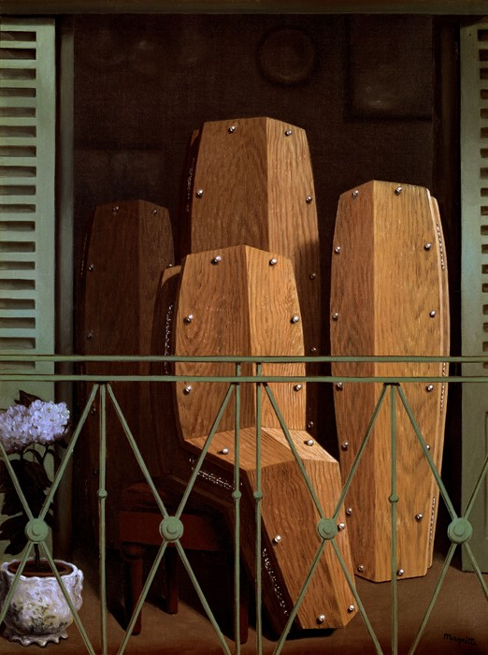
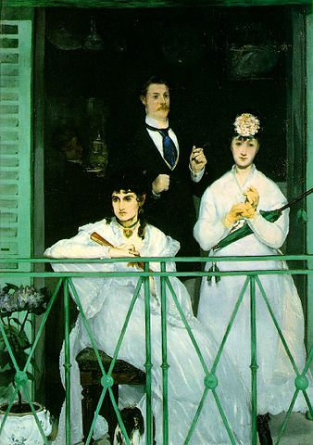
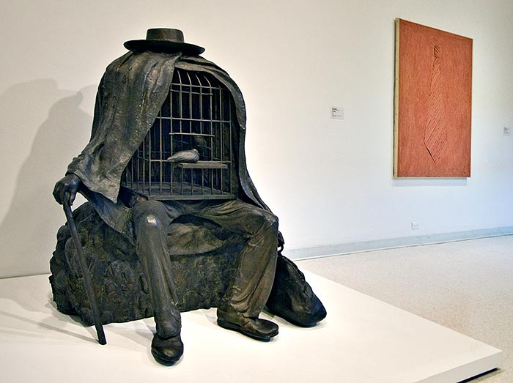
Rene Magritte stayed in Brussels for the remainder of his life and did Surrealism for most of it.
During the course of his career, Rene Magritte would also use famous paintings, which were created by other artists, to put his own surrealist twist on it. One of the works he did, was recreate The Balcony (a piece after the masterpiece of the same name, by Eduard Manet.
He had a playful and provocative sense of humor. One such example of this is the series of pipe paintings which he created.
The fascination he had with a paradoxical world, is clearly seen when you view the entire series as a whole piece, rather than viewing the images on their own.

Slide 9
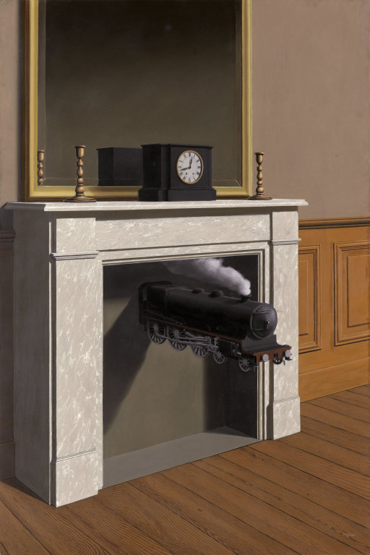
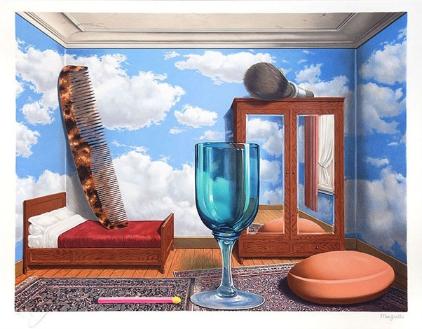
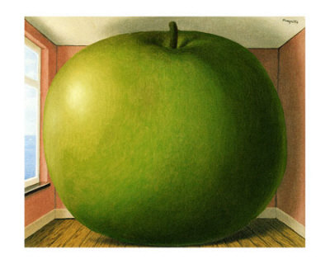
“If the dream is a translation of waking life, waking life is also a translation of the dream. ”-Rene Magritte
Magritte influenced many future artists.
His ability to present figures in a suggestive, yet questioning manner, made his work extremely desirable, especially during the 1960s. He died in 1967, of pancreatic cancer.

