Slide 1
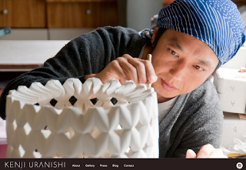
Kenji Uranishi

Slide 2
Kenji is a ceramic artist from Japan. He moved to Brisbane, Australia in October 2004. He makes very beautiful and charming functional works as well as some one off art piece. Kenji works with porcelain and his porcelain technical skill is very high. I am amaze to see how he join of bit and pieces of porcelain slab together with out any crack!

Slide 3
His studio is on the first floor next to the garage. It has a big glass door lead to the front yard. Near the glass door is a small slab roller that help him make clay slab. Kenji mention that it will take him a whole day to make slabs from one bag of clay. His slab is very thin and very fragile. He leave the slabs overnight to firm up before he starts working on them.

Slide 4
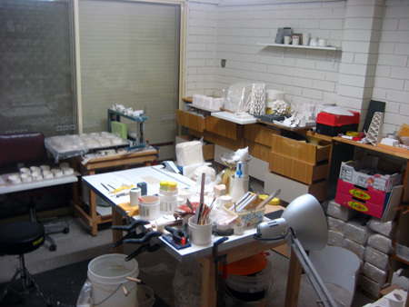
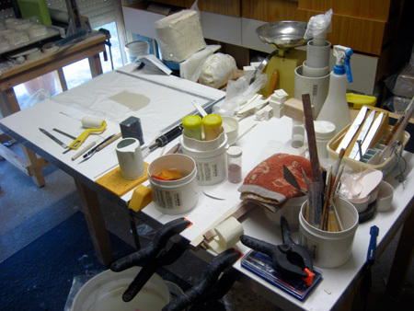

Slide 5
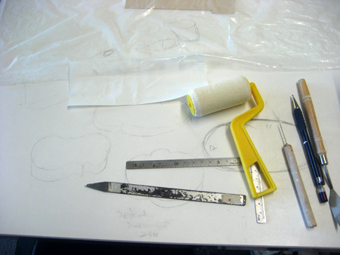
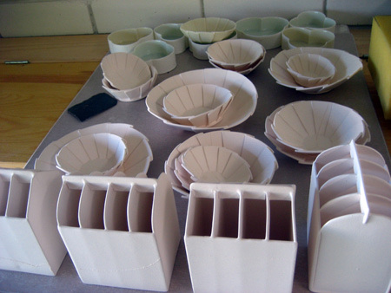

Slide 6
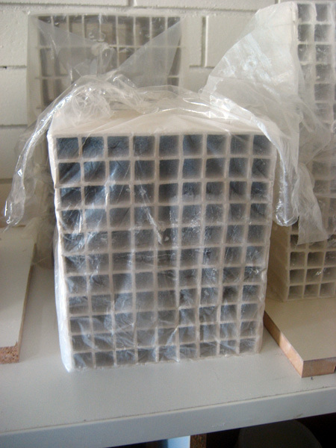

Slide 7
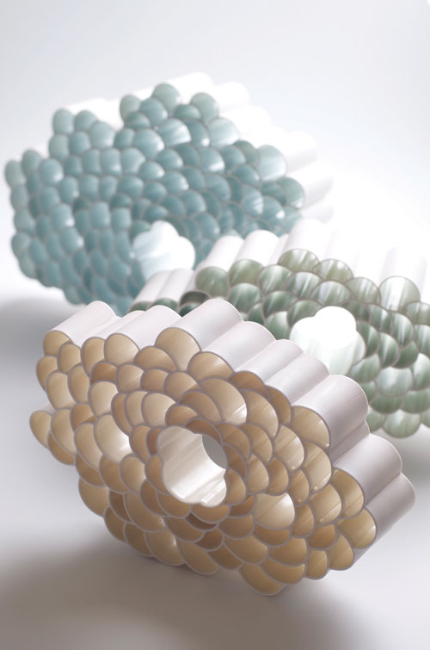

Slide 8
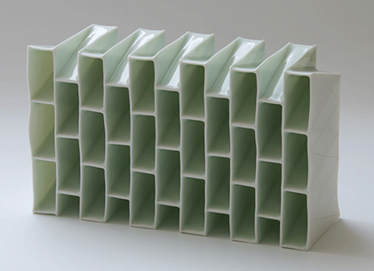

Slide 9
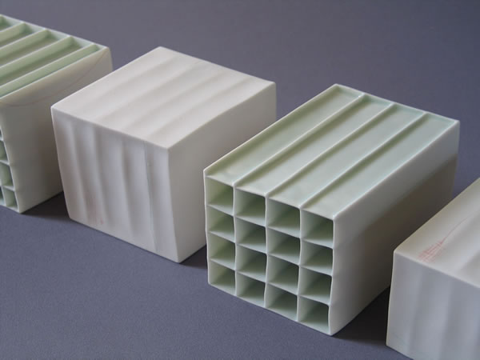

Slide 10
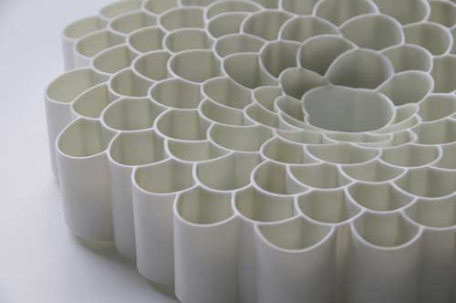

Slide 11
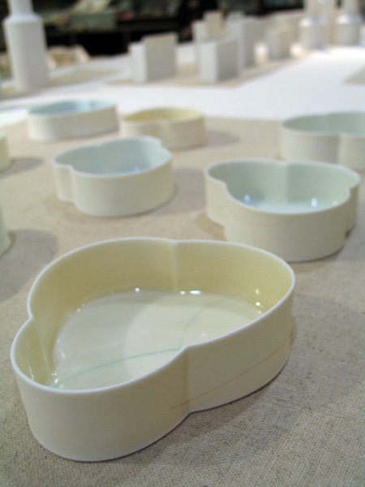

Slide 12
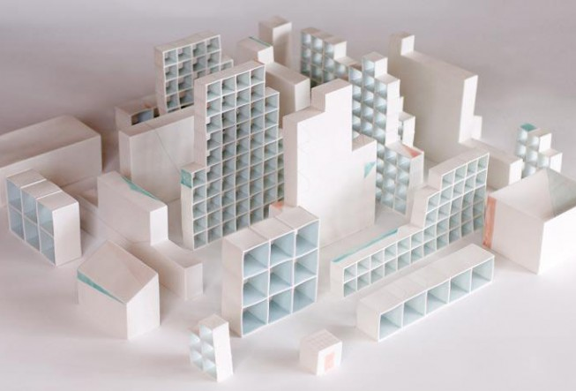

Slide 13
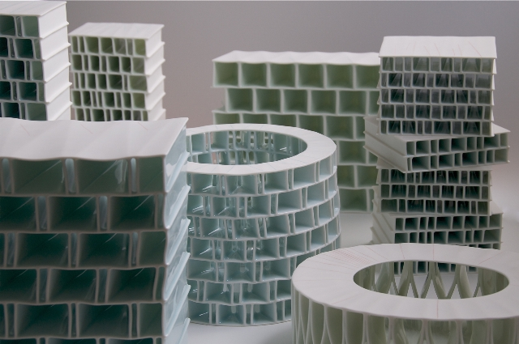

Slide 14
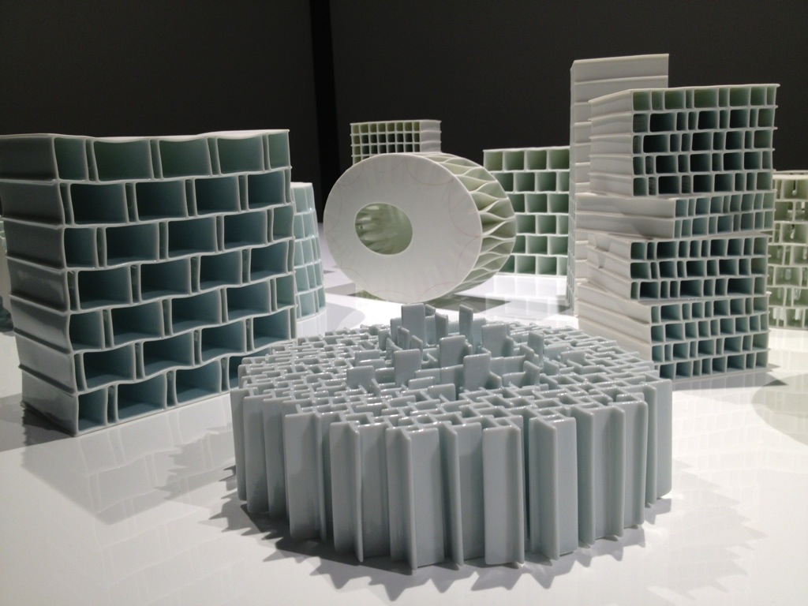

Slide 15
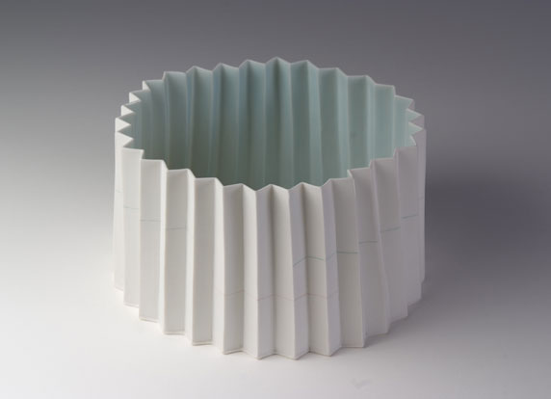

Slide 16
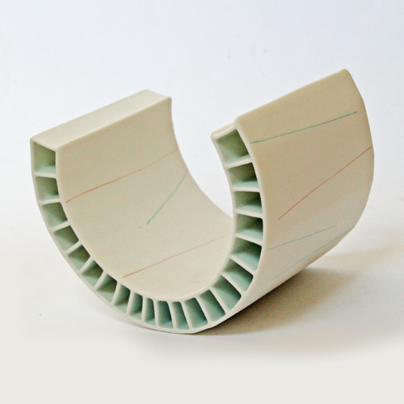

Slide 17
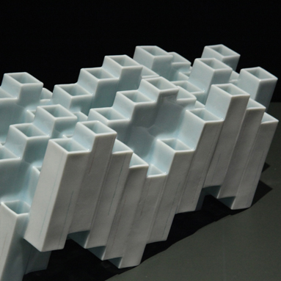

Slide 18
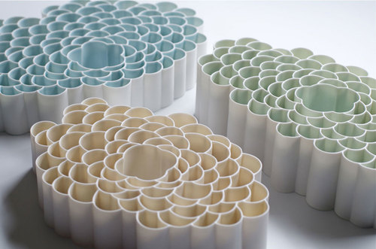

Slide 19
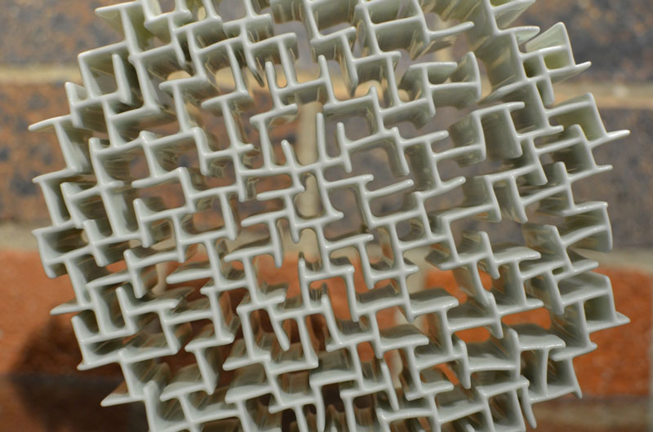

Slide 20
“I am interested in and influenced by architecture and nature,
and how people interact with both.”
“The most important lesson I’ve learned as a working artist is not
To get upset when I open the kiln and am faced with disaster.
While it can be disappointing, I try to find the positive in what’s
Happened, learn something from it, and move on.”

Slide 21
His internal measurement of kiln is 18 inches square.

