Slide 1
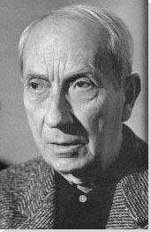
Jean Arp
(Hans) Arp
French-German-American Sculptor, Painter, and Collagist
Movements and Styles: Dada, Surrealism
http://www.theartstory.org/artist-arp-hans.htm

Slide 2
Born: September 16, 1886 - Strasbourg, Alsace
Died: June 7, 1966 - Basel, Switzerland
"Art is a fruit that grows in man like a fruit on a plant or a child in its mother's womb."

Slide 3
Synopsis
Something of a one-man movement, Jean Arp could (and did) make anything into art. Best-known for his biomorphic sculptures, and one of the most versatile creative minds of the early twentieth century, he fashioned sculptures out of plaster, stone and bronze, and also expressed himself in paintings, drawings, collages and poems. His approach to form, often referred to as organic abstraction, was remarkably consistent: his wavy lines suggested plants, body parts and other natural motifs, while remaining entirely abstract.
Like an extraterrestrial on earth for the very first time, Arp's genius was in presenting visual information as if he is first seeing it. Transformation, growth, fecundity, and metamorphosis are among the dominant themes in his work.

Slide 4
Arp's work is non-representational, yet firmly rooted in nature. His most abstract compositions suggest organic forms. This keeps the viewer curious, and provides a consistent framework for satisfying the eye.
Arp is a transitional figure. As one of the founders of Dada, and subsequently an active participant in Surrealism, his work forms a link between these two major movements of the early twentieth century.

Slide 5
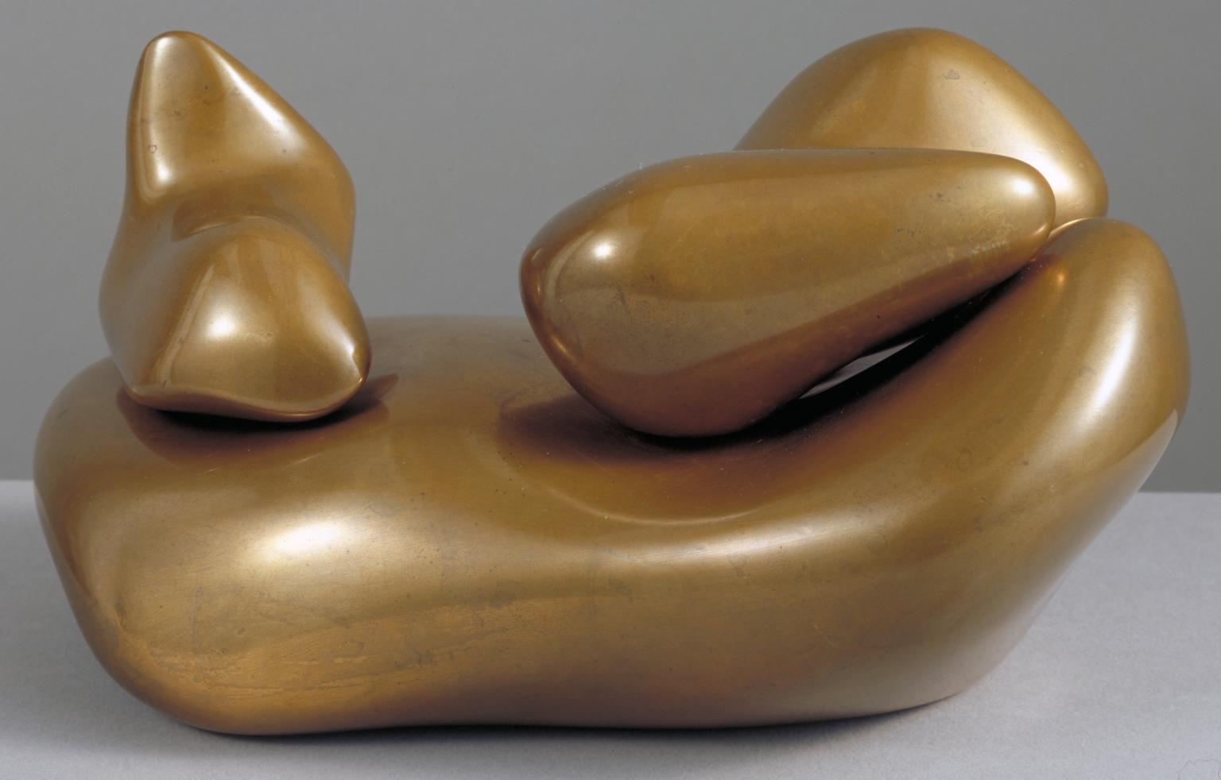
Artwork Images | Sculpture to be Lost in the Forest (1932, cast c.1953-8) Artwork description & Analysis: Arp usually created his sculptures in plaster, sanding away until he found the satisfying shape, and thought up the titles only when the work was complete. This sculpture, a bronze cast of an earlier plaster form, resembles a configuration of heavy objects: boulders, sacks, or figures on a bed. Rooted in Arp's lifelong fascination with the physiological processes of growth and death, the work's title strongly suggests some sort of landscape, but evokes multiple associations that shift as one looks at the work. This is exactly how the artist wanted it. Like Duchamp and others in the Dada circle, Arp believed that the viewer completes the work of art. Sculpture to be Lost in the Forest is a prime example of Arp's ability to balance abstraction with allusion. His forms are constantly in flux and morphing, sometimes toward and sometimes beyond recognition. Bronze - Tate Gallery, London

Slide 6
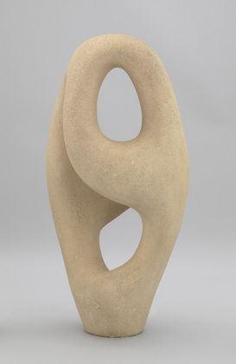
Ptolemy (1953)
Artwork description & Analysis: Arp was keenly interested in opposites. In this particular sculpture the contrast between material and emptiness is showcased by the smooth limestone surface, with its elegant line twisted form embracing two gaping voids. Named after the Greco-Egyptian mathematician, astronomer, geographer, and astrologer Claudius Ptolemy (who was also interested in opposites) this work is about being and nothingness, and the complex relationship between nature and humanity, which were inseparable for Arp. Carola Giedion-Welcker described Arp's conception of nature as "an immense vital process, both extraordinarily simple and complex, a cycle evolving between birth and death, constantly changing and growing, and hence to be grasped only dynamically, never statically in the field of art... We detect in Arp the profound experience of life, which conceives of creation as an eternal process, as permanent transformation and growth... This is why Arp's initial forms strike us as being so ready to be transmuted, so filled with inner organic tension."

Slide 7
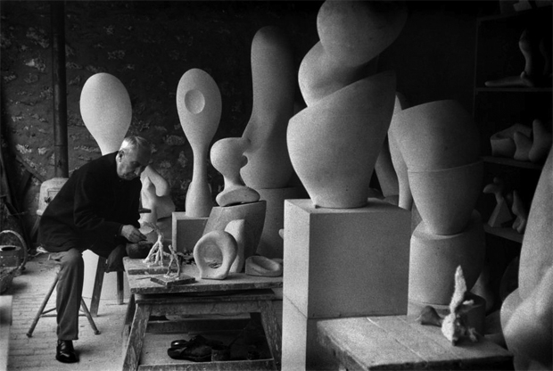

Slide 8
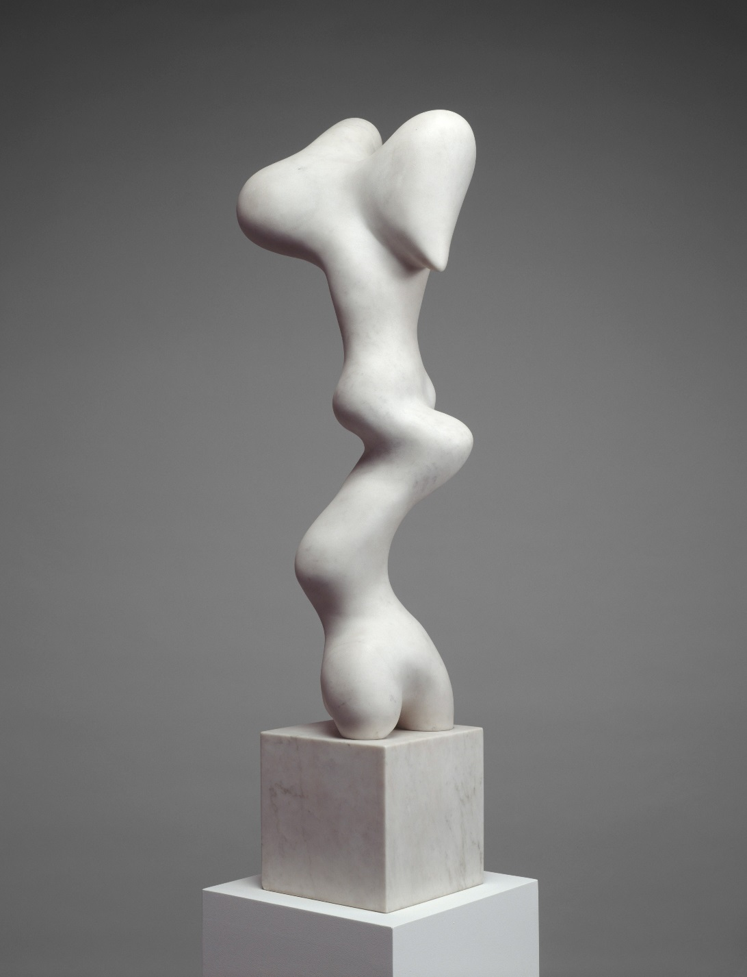
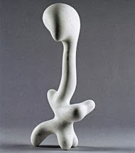
Draw 1 sculpture.

Slide 9
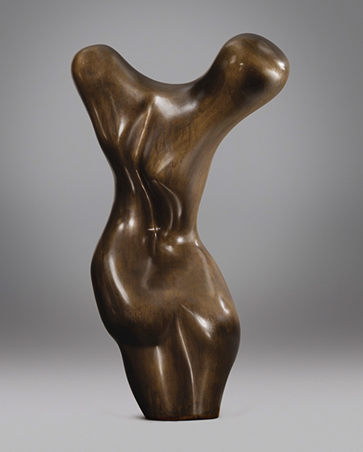
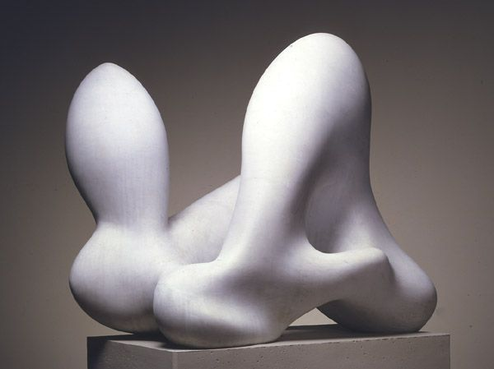

Slide 10
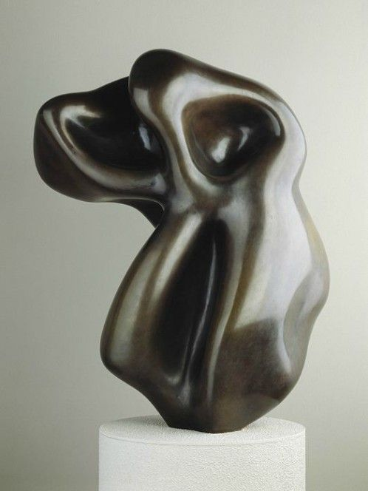
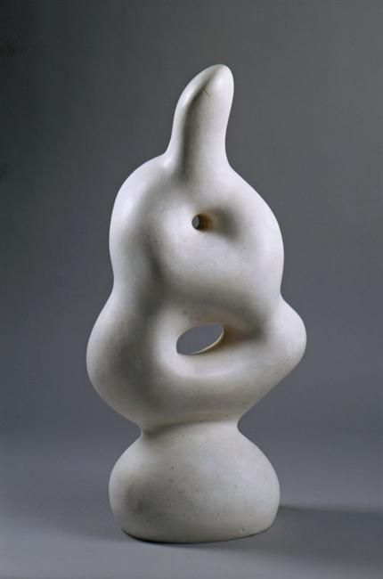
Draw
1
sculpture.

Slide 11
Plaster
1. Prepare container
2. Mix Plaster
½ plaster, ½ warm water
Pancake consistency
3. Set up container form, tap out air bubbles
4. Place on Shelf

Slide 12
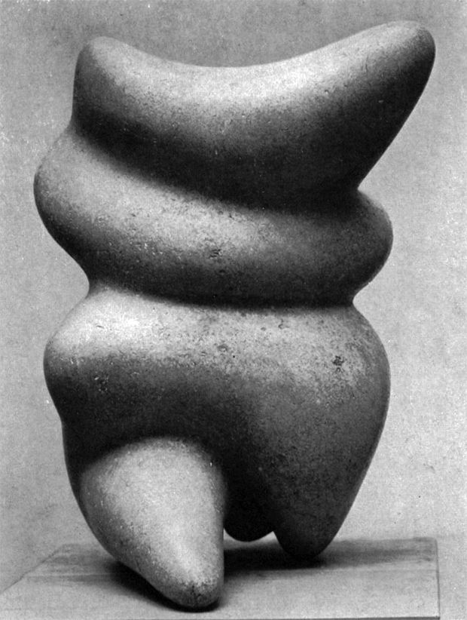
Soap Challenge!

Slide 13
Plaster Design
1. Unveil plaster sculpture
2. Draw the present sculpture in sketchbook
3. Draw your inspiration for sculpture.
4. Design your sculpture.
Focus:
Movement, Line, Form, Balance, Value

Slide 14
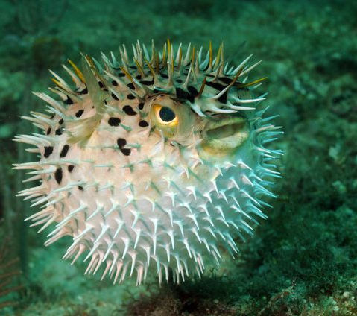
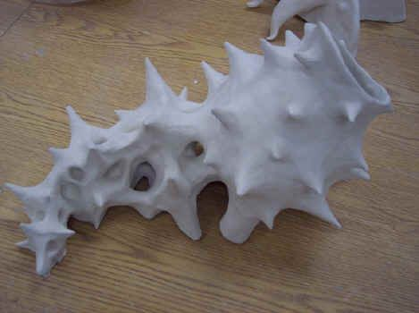
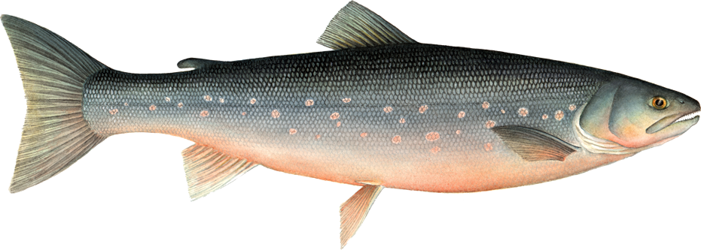
Plaster Sculpture Design- Full Page 12/1/17
Draw your inspirations.
Draw your finished plaster sculpture.
Draw your current sculpture.
Show Mrs. Soto for a grade.

