Slide 1
Introduction to Sculpture
A brief history

Slide 2
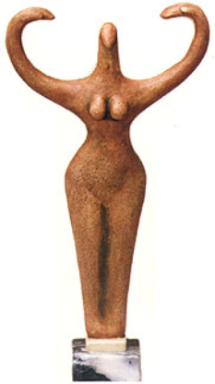
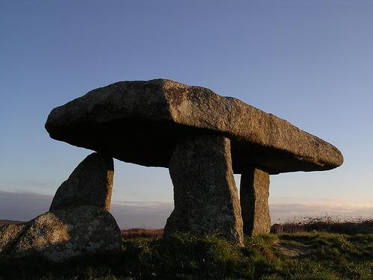
Sculpture is a vital part of civilizations across the globe.
Megalith, England, 2500 B.C.
Fertility Bird Goddess, Egyptian
3600 B.C.

Slide 3
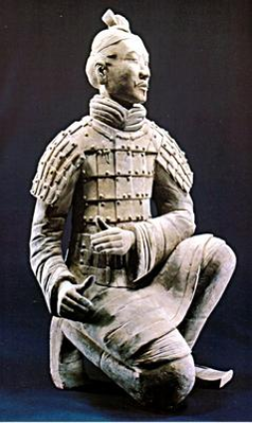
Sculpture is a record of human existence.
Sculpture is a reflection of the society in which it is produced.
Terracotta warrior from the
Qin Dynasty (221-206 BC)

Slide 4
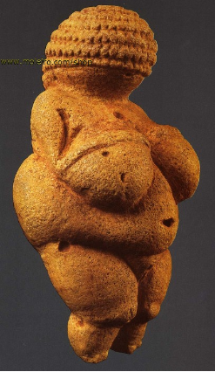
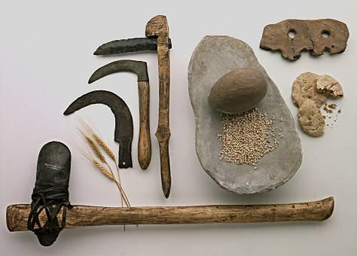
Early sculptures of the Paleolithic and Neolithic eras were likely for symbolic or religious, as well as practical means.
Venus of Willendorf, Austria, 25,000 B.C.
Neolithic tools, 6,000 B.C..

Slide 5
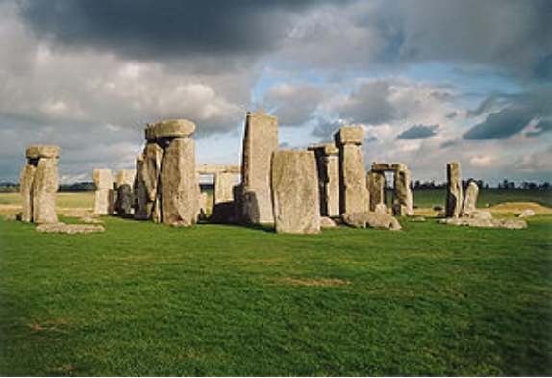
Some ancient sculpture’s meanings remain a mystery.
Stonehenge, England, 3100 B.C.

Slide 6
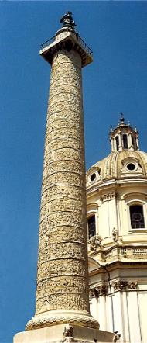
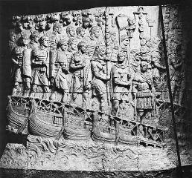
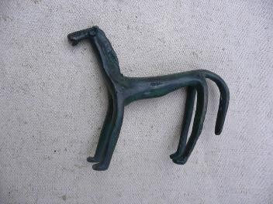
From small, hand held pieces to monuments, traditions of carving, casting and modeling emerged in these early sculptures.
Trajan’s Column, Italy, 106 A.D.
Bronze horse, 1000 B.C.

Slide 7
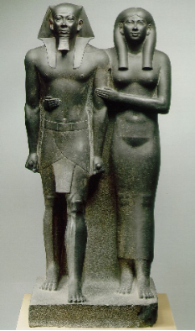
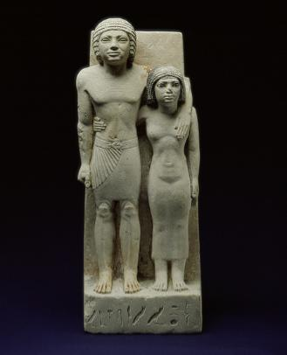
Sculptures of ancient empires recorded both religious and political life.
Artisans of these cultures often used techniques and methods that continued unchanged for centuries.
Menkaure and his queen, Egypt, 2550 B.C.
Statue of Memi and Sabu, Old Kingdom, Dynasty 4,
ca. 2575–2465 B.C.

Slide 8
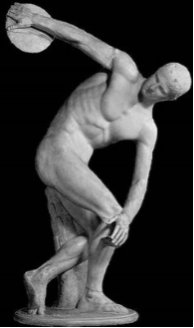
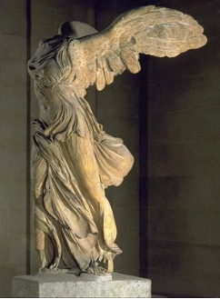
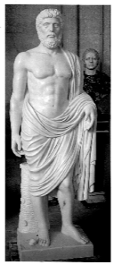
Sculpture of Ancient Greece and Rome is one of the greatest achievements of Western Art
This work often focused on perfecting the human form.

Slide 9
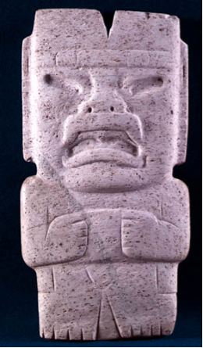
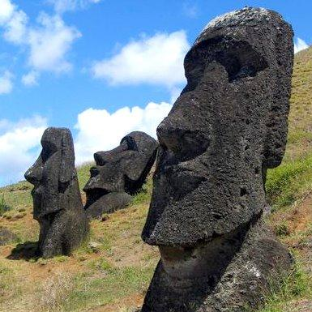
During this same time, distinct sculptural traditions developed in other areas of the world.

Slide 10
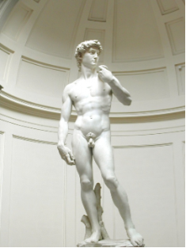
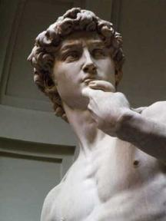
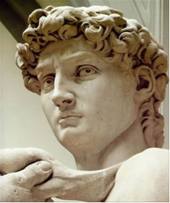
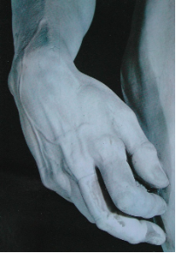
During the Renaissance, artists again looked to perfecting the human form.
Michelangelo sought to release the image that was “locked” in the stone.

Slide 11
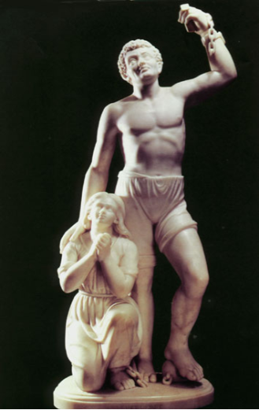
Artists continued to work in this style into the 20th century
Edmonia Lewis, one of the only female African American sculptors of the time, sculpted figures that represent both the beauty of the human figure while presenting thought provoking content.

Slide 12
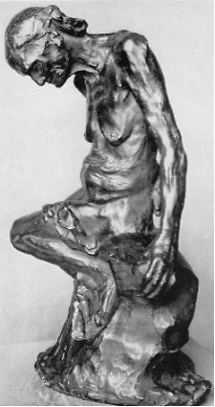
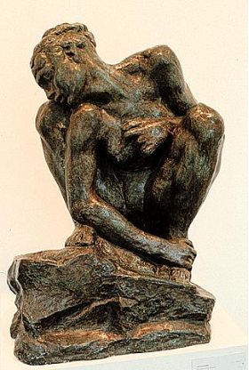
In the 19th and early 20th century, artists shifted from portraying realistic figures in favor of distorted and abstracted forms.
Auguste Rodin

Slide 13
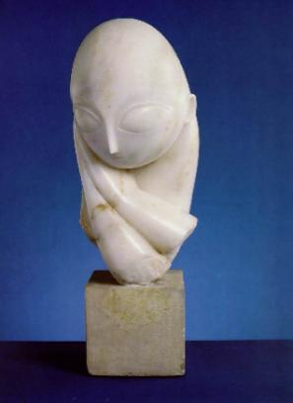
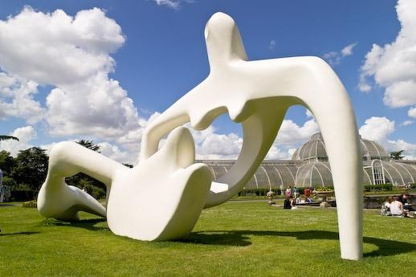
This abstraction of form carried on into the 20th century.
Henry Moore
Constantin Brancusi

Slide 14
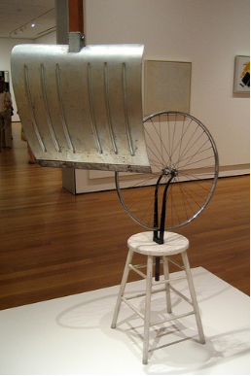
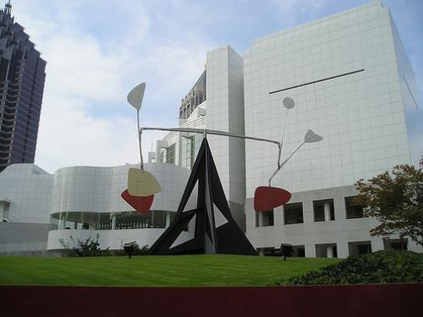
Some artists shunned traditional materials and methods and created entirely new types of sculptures.
Marcel Duchamp
Alexander Calder

Slide 15
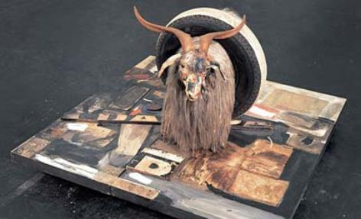
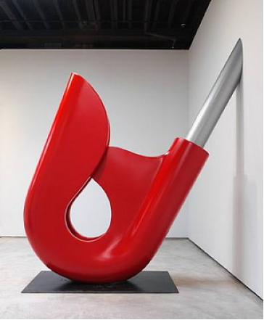
Some artists shunned traditional materials and methods and created entirely new types of sculptures.
Robert Rauschenburg
Claes Oldenburg and Coosje van Bruggen

Slide 16
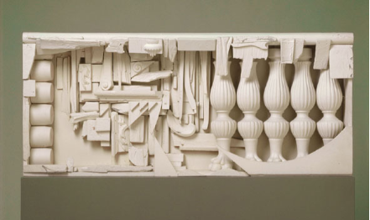
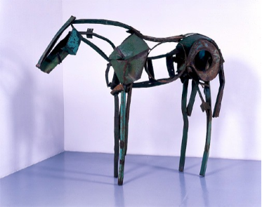
Contemporary artists continue to redefine sculpture as an art form.
Louise Nevelson
Deborah Butterfield

Slide 17
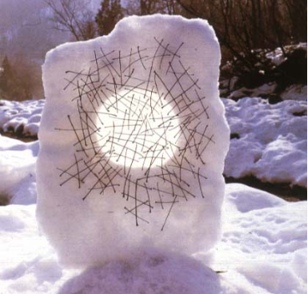
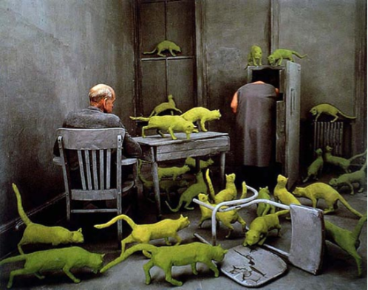
Contemporary artists continue to redefine sculpture as an art form.
Andy Goldsworthy
Sandy Skoglund

Slide 18
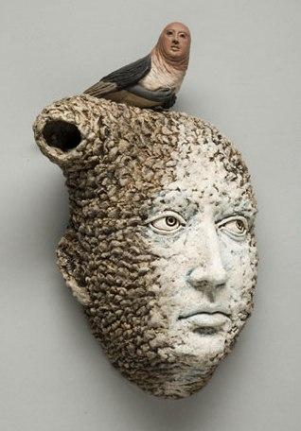
Contemporary artists continue to redefine sculpture as an art form.
Adrian Arleo

Slide 19
However sculpture is defined, it is more than just a three dimensional object.
3 fundamentals must be present:
Form: The configuration the idea takes whether recognizable or not that demonstrates skillful use of elements and principles.
Content: The emotion, passion or message the sculptor intends to convey and how the viewer interacts with the piece.
Technique: The sculptor’s ability to effectively use materials and tools. Craftsmanship.

Slide 20
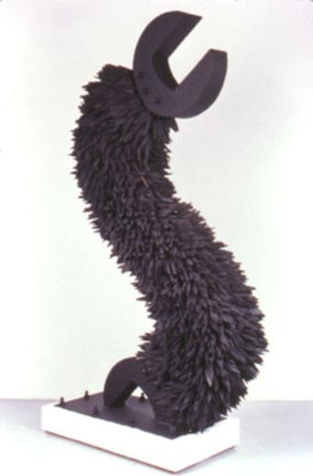
Form
How has the artist successfully demonstrated the elements and principles?
Chakaia Booker

Slide 21
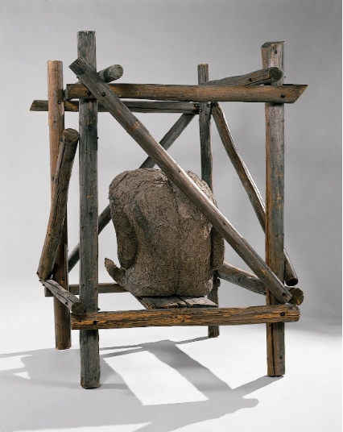
Content
What message or feeling is the artist conveying?
Magdalena Abakanowicz

Slide 22
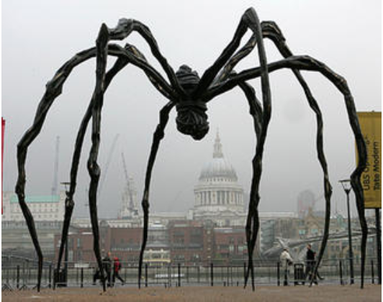
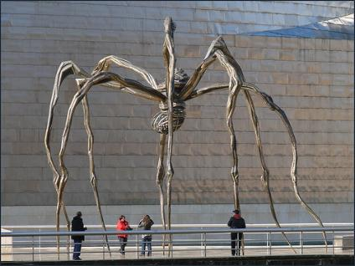
Technique
Was the artist able to effectively use materials and tools? How did the subject inform her choices?
Louise Bourgeois
Notes:
Over 30 feet tall-stainless steel-bronze casts made off this original at other locations

