Slide 1
Franz Marc
German Expressionism

Slide 2
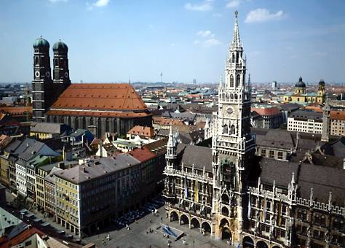
Franz was born in Munich in 1880

Slide 3
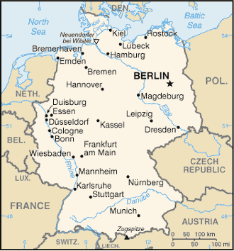
Munich is located in Germany…
And Germany is located in…

Slide 4
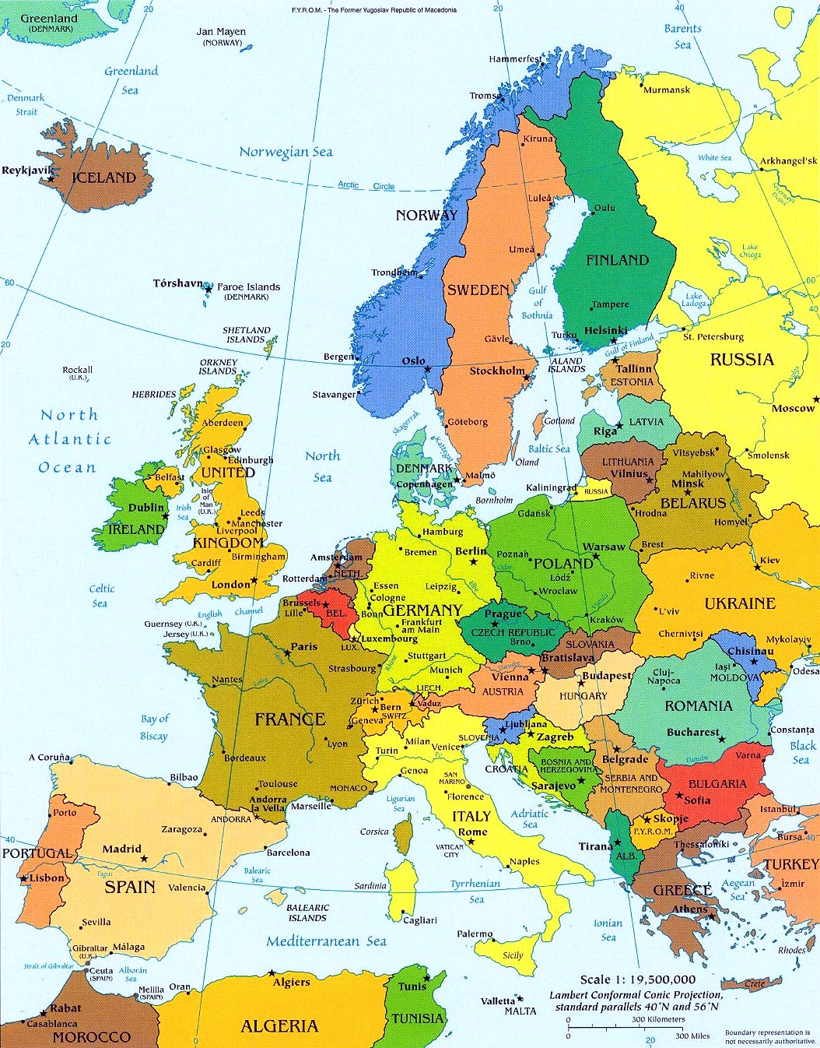
… Europe!

Slide 5
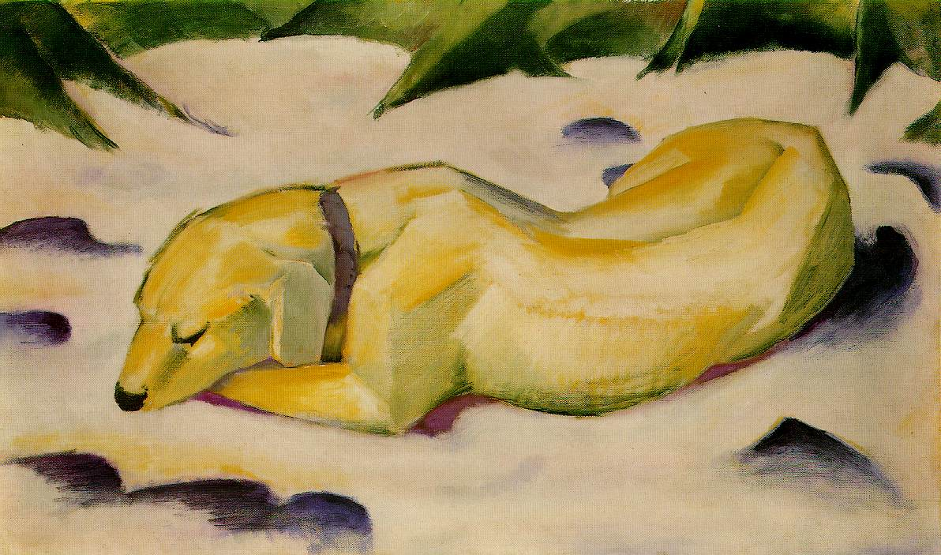
Franz Marc loved to paint animals …
Dog Lying in the Snow 1910-1911

Slide 6
When Franz Marc paints he uses…
BRIGHT primary and secondary colors
NON-REALISTIC colors and shapes for his animals
his feelings: EXPRESSIONISM

Slide 7
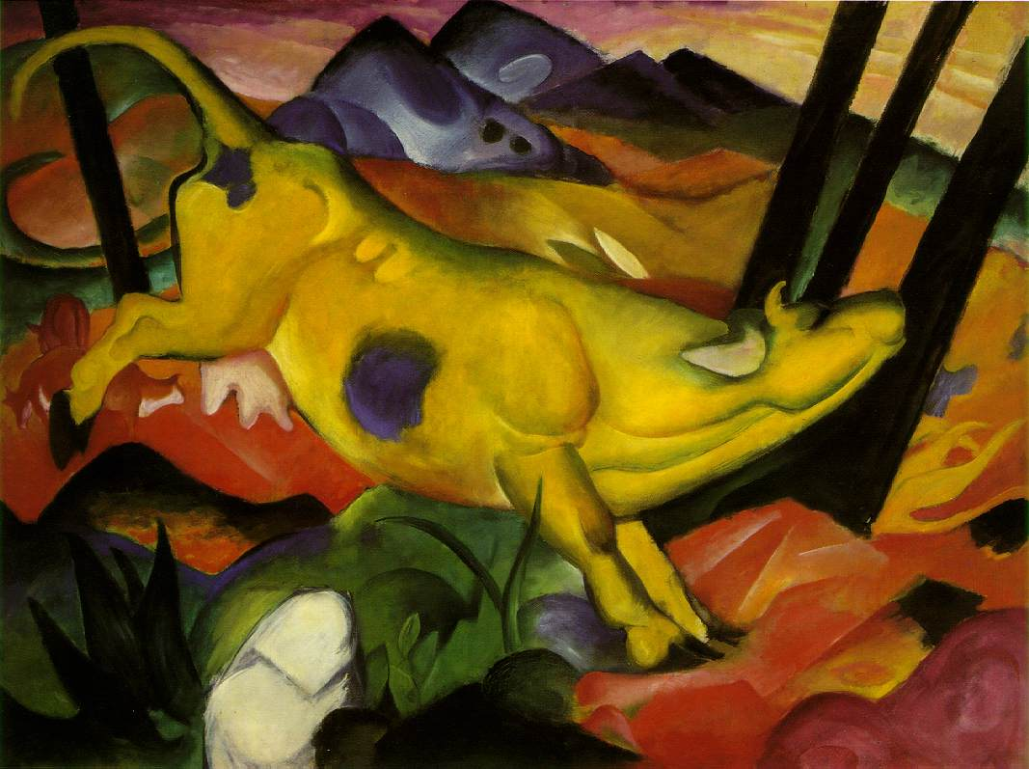
The Yellow Cow 1911

Slide 8
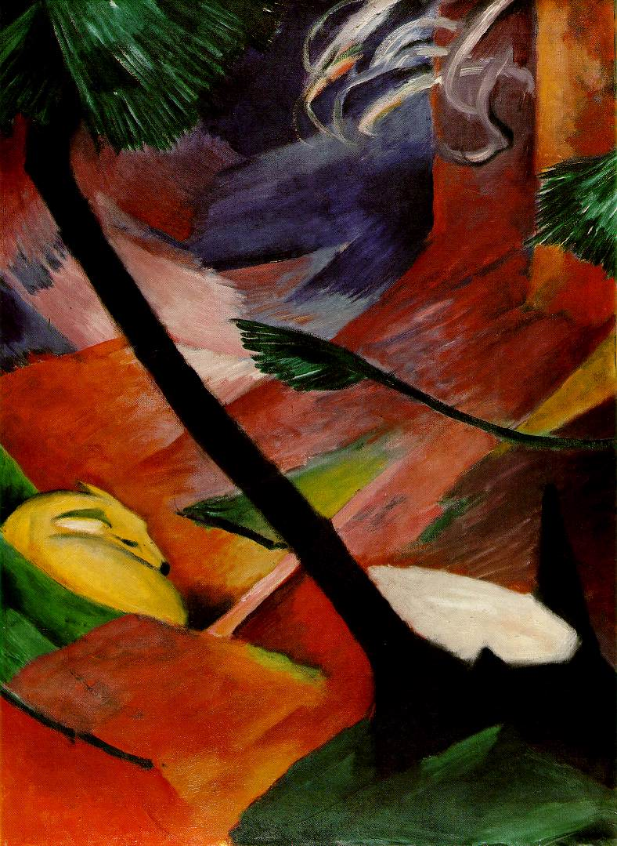
Deer in the Woods II
1912

Slide 9
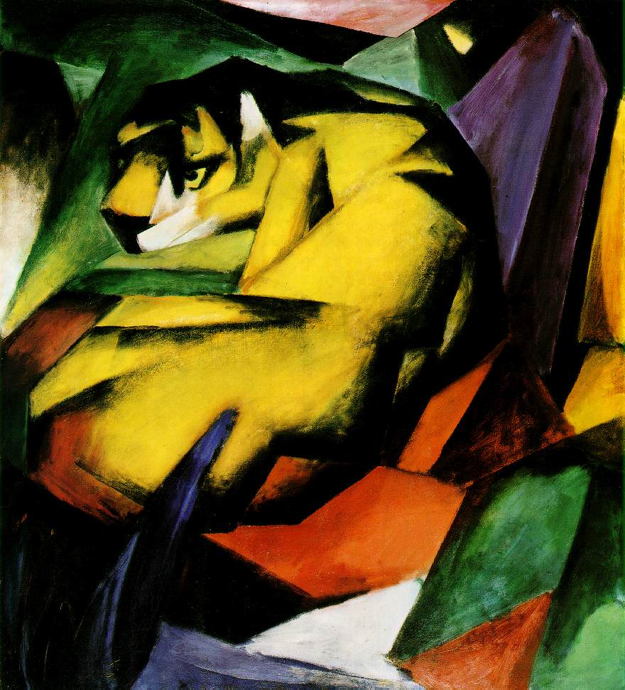
Tiger
1912

Slide 10
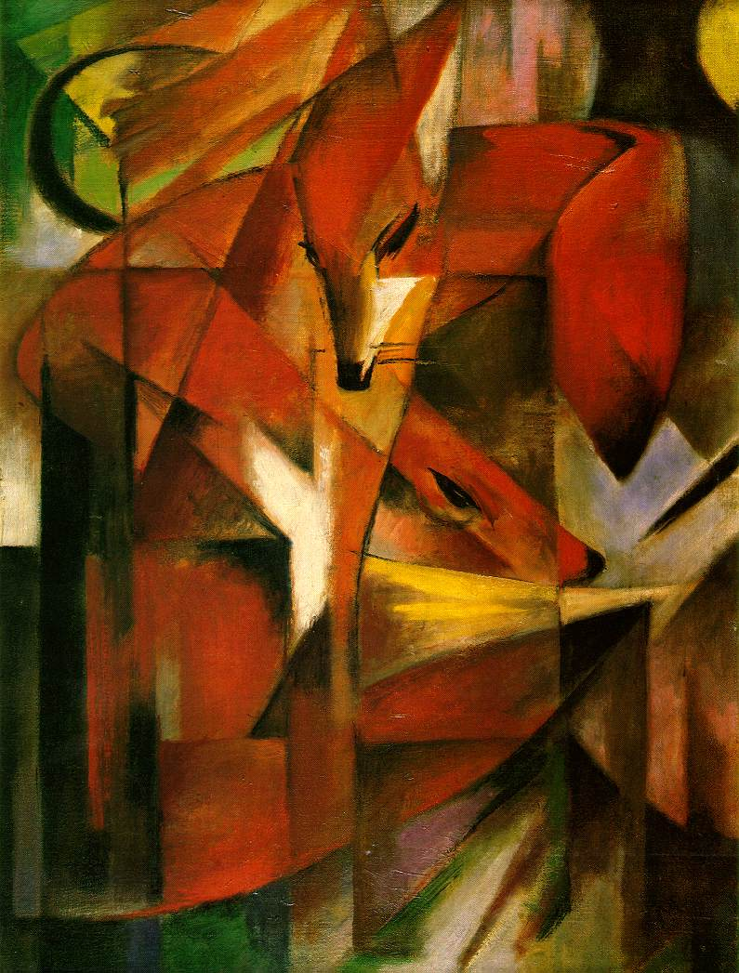
Foxes
1913

Slide 11
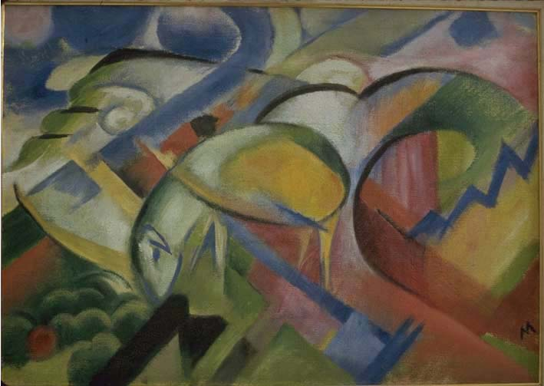
The Lamb 1913-1914

Slide 12
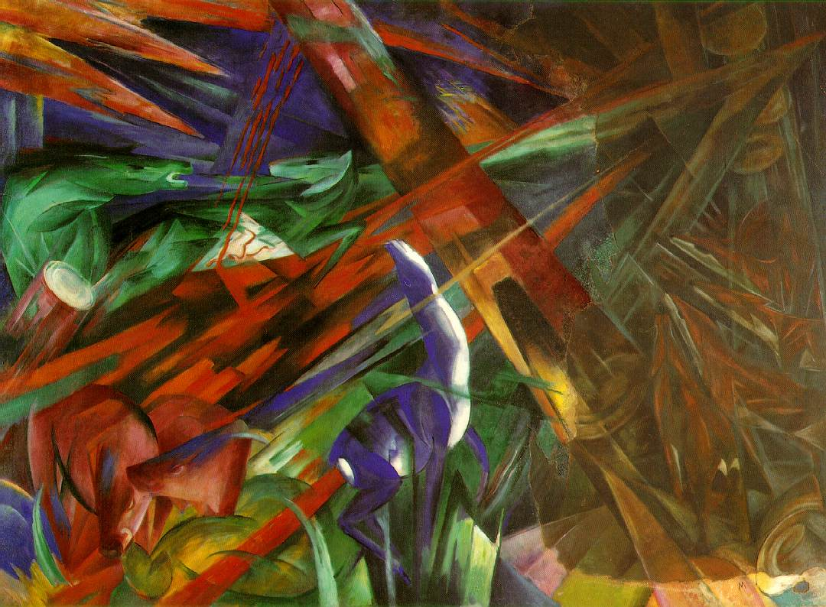
The Fate of the Animals 1913

Slide 13
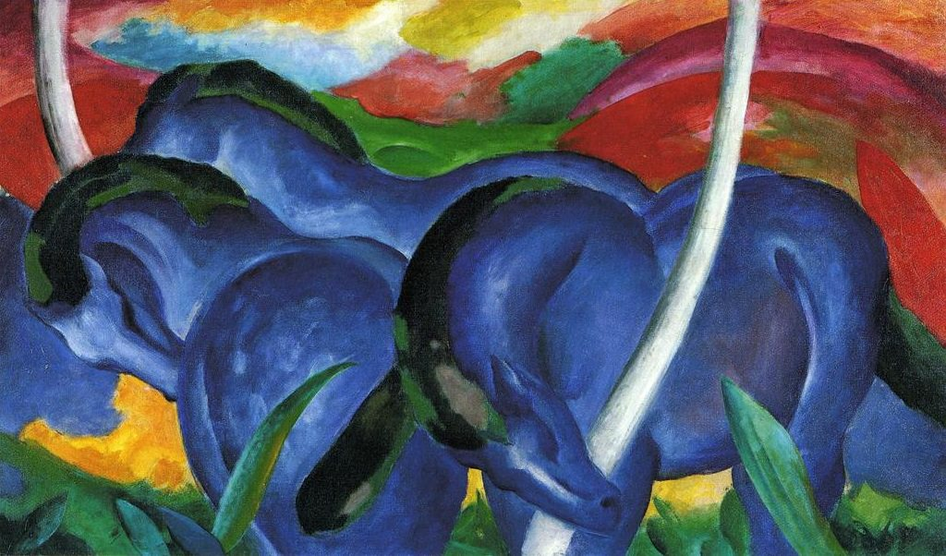
Expressionism
Franz Marc
www.franzmarc.org/

