Slide 1
Drawing 1
Prompts

Slide 2
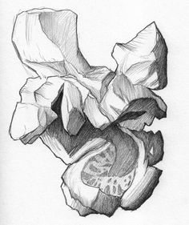
Popcorn!

Slide 3
http://afaithfulattempt.blogspot.com/2011/06/popcorn-interpretive-drawing.html
Pen
Pencil
Charcoal
Black Paper

Slide 4
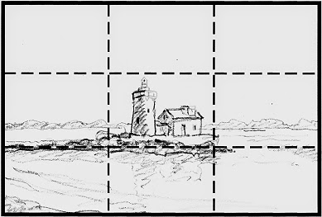
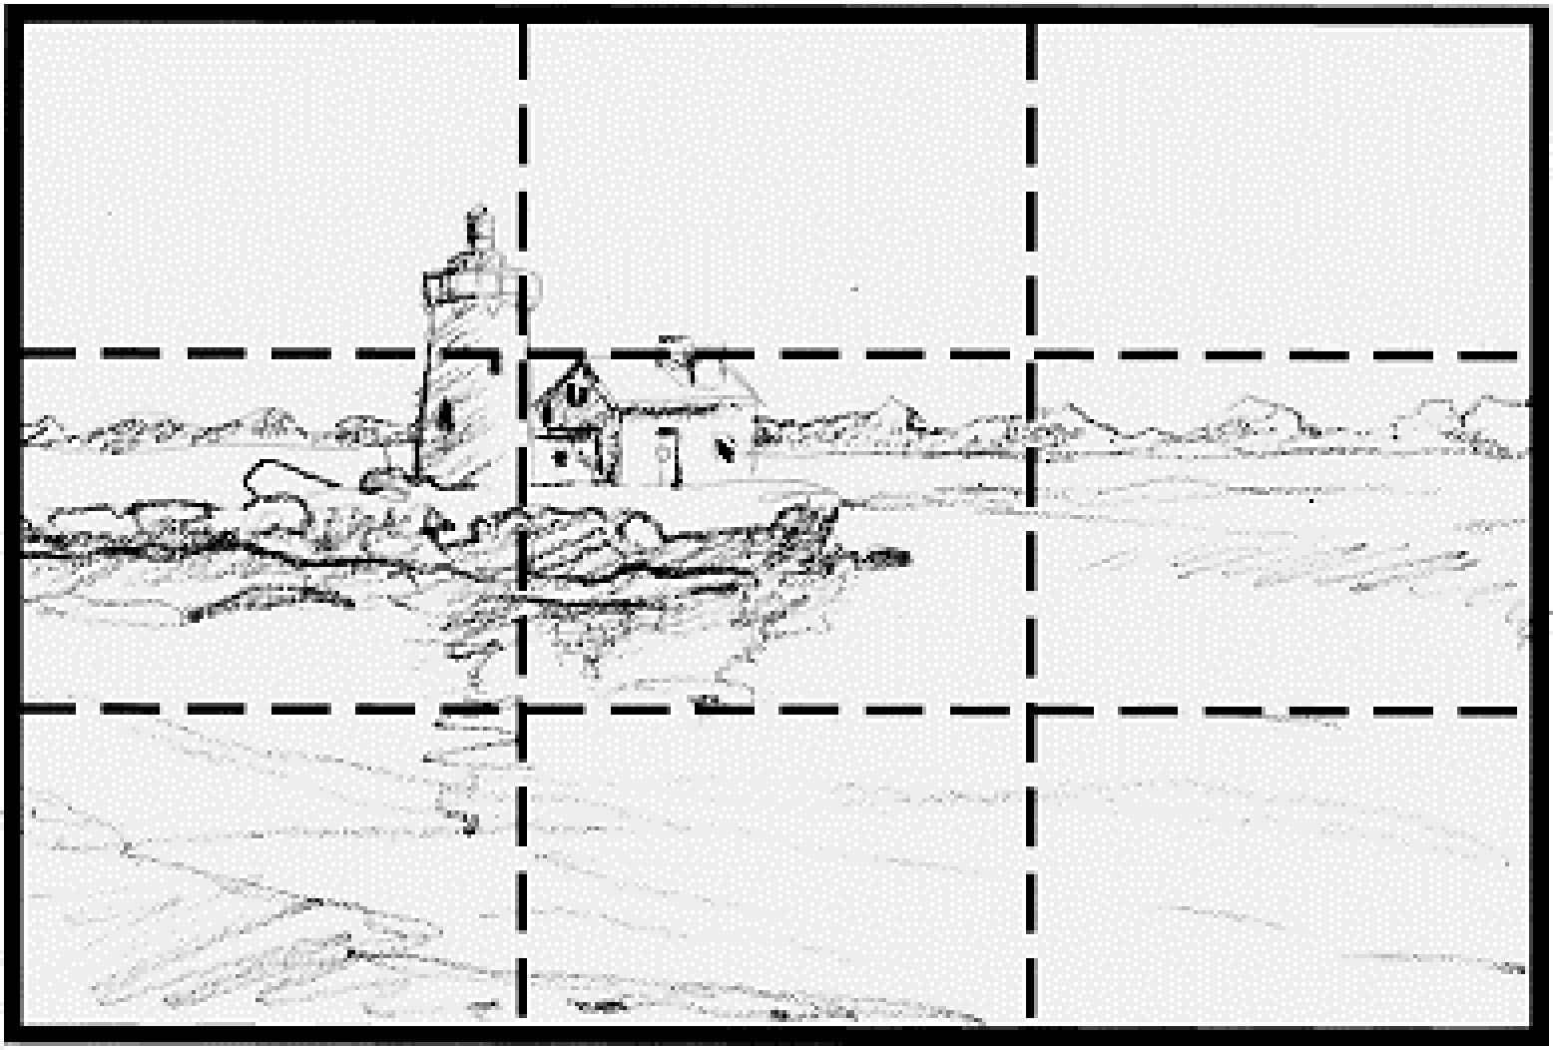
Composition Rule of Thirds

Slide 5
Graphite
Draw 2-3 pieces of popcorn
Investigate which side you want to draw
Popcorn drawing should be 2-3inches
4 values minimum (1, mid-tones, 10)

Slide 6
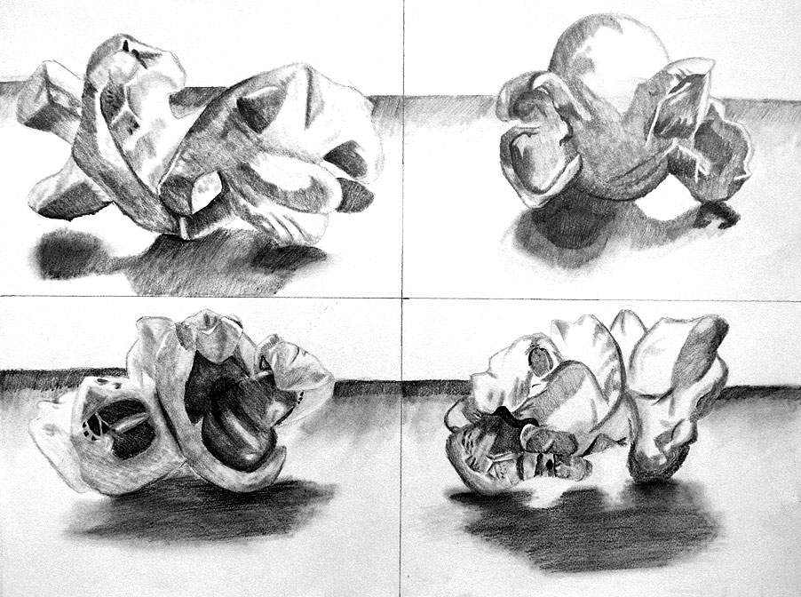
10 minutes
Sketchbook
Practice

Slide 7
Graphite
4” x 5”
4+ Values
2-3 pieces of popcorn
Strong Composition

Slide 8
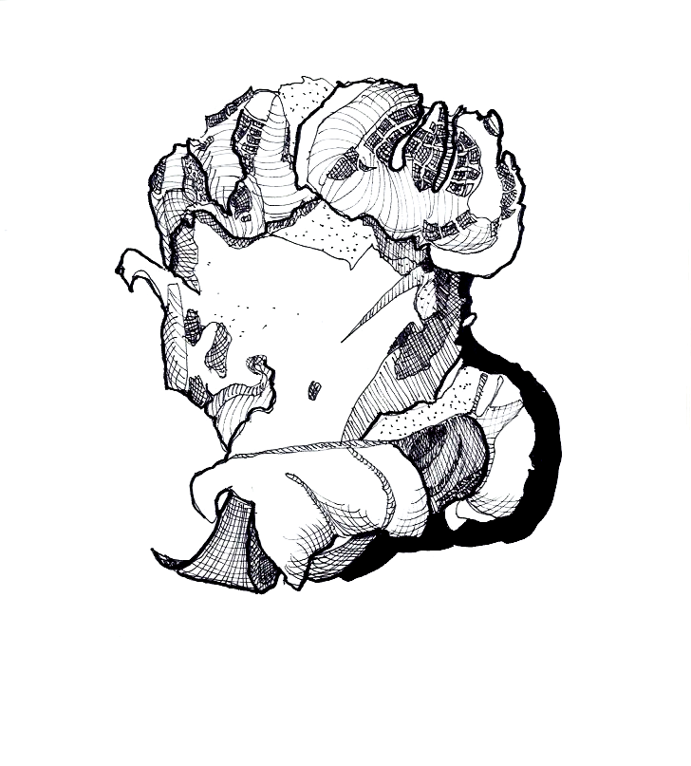
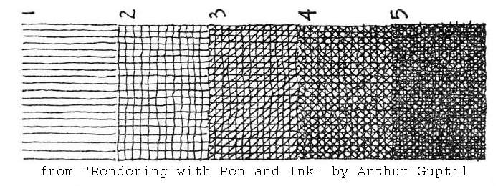
Ink
4” x 5”
4+ Values
2-3 pieces of popcorn
Strong Composition

Slide 9
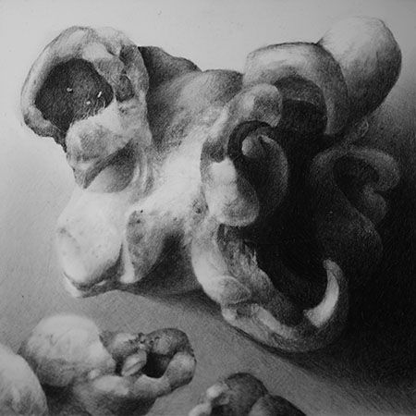
Charcoal
4+ Values
2-3 pieces of popcorn
Strong Composition
2”-3” size of popcorn

Slide 10
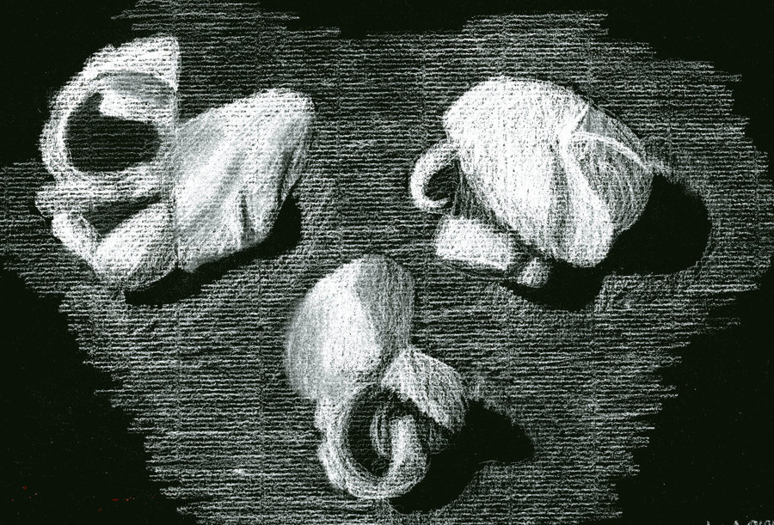
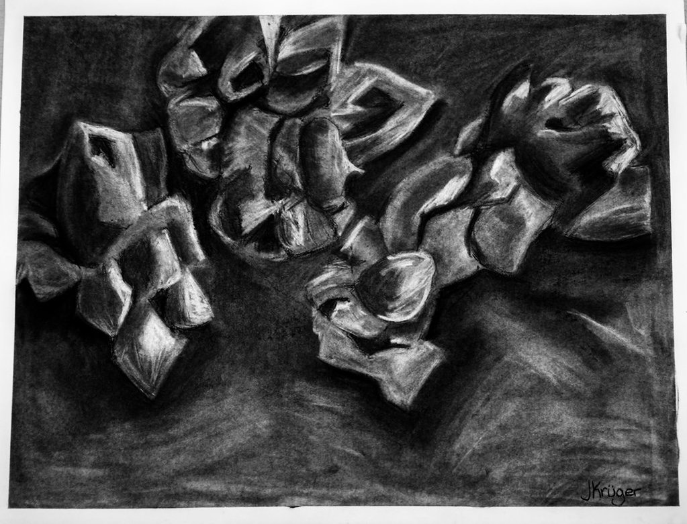
White Charcoal on Black Paper
4+ Values
2-3 pieces of popcorn
2”-3” size of popcorn
Strong Composition

Slide 11
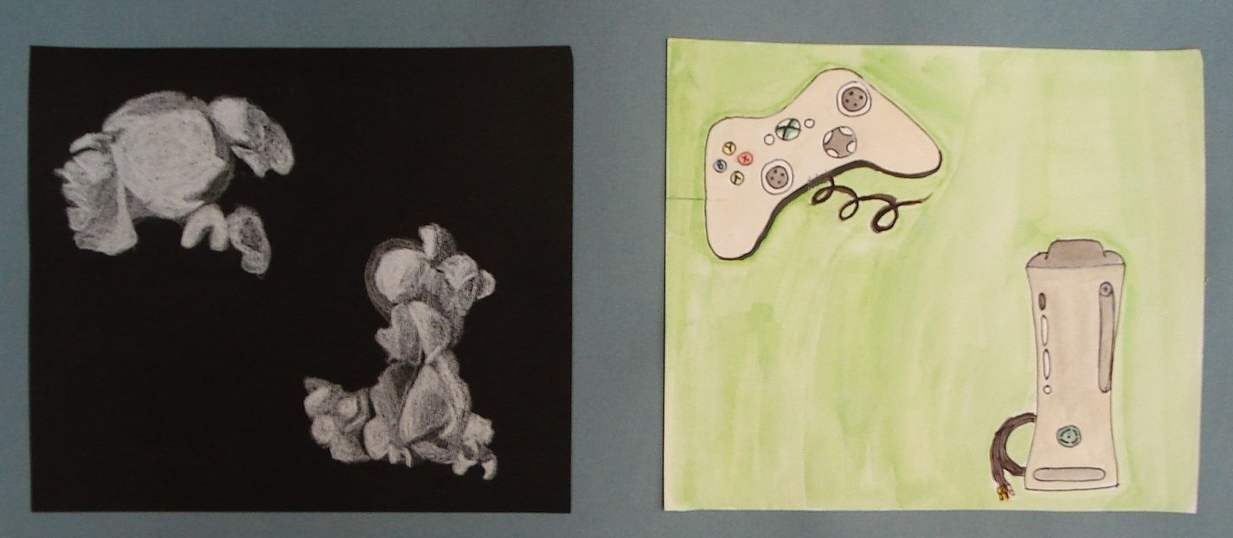
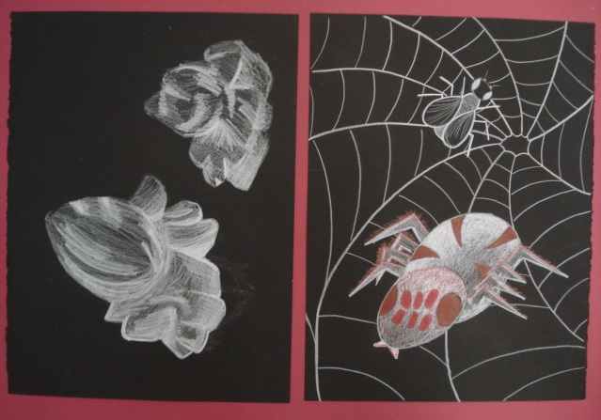
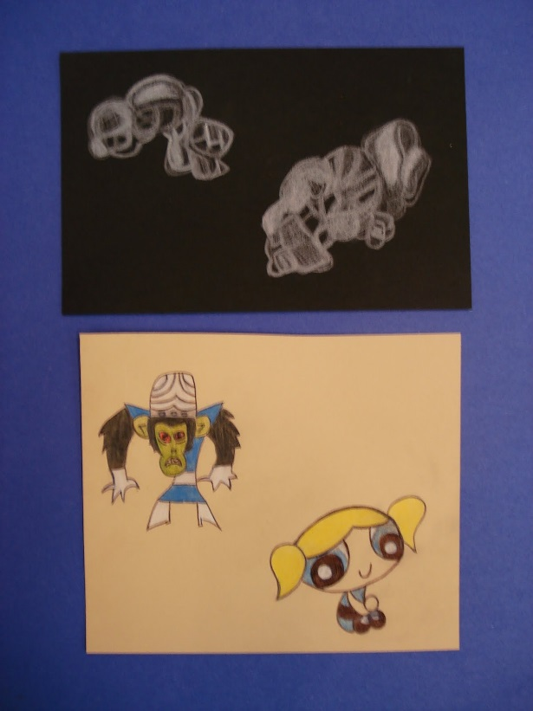
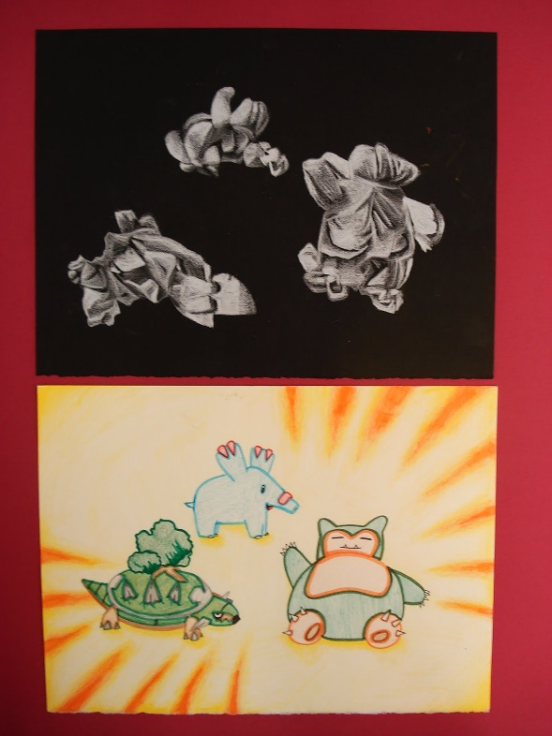
Creative Popcorn
Turn your popcorn into
objects!!!!
8in x 4in

