Slide 1
Clayton Thiel
www.claytonthiel.com

Slide 2
Clayton Thiel
-Born in St Charles, Missouri in 1956.
-BA in sculpture from Maryville University in 1979,
Then came to California to study with Peter Voulkos& Joan Brown at UC Berkeley. At San Jose State he studied with David Middlebrook & Stan Welsh
-Received an MFA in 1985 (suma cum laude).
-He has been a full-time professor of Sculpture (clay, stone, and bronze), Art History, and Design Chabot College in Hayward, CA since 1990.

Slide 3
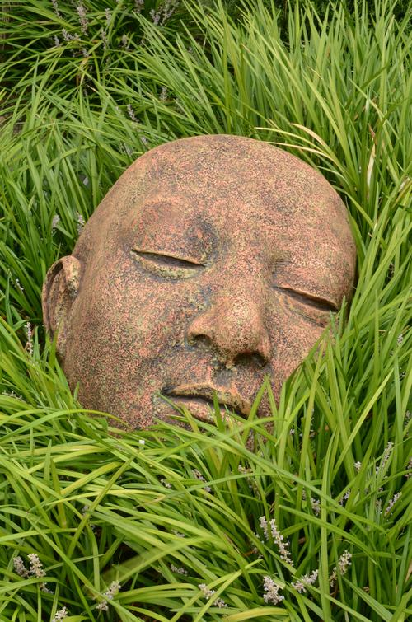

Slide 4
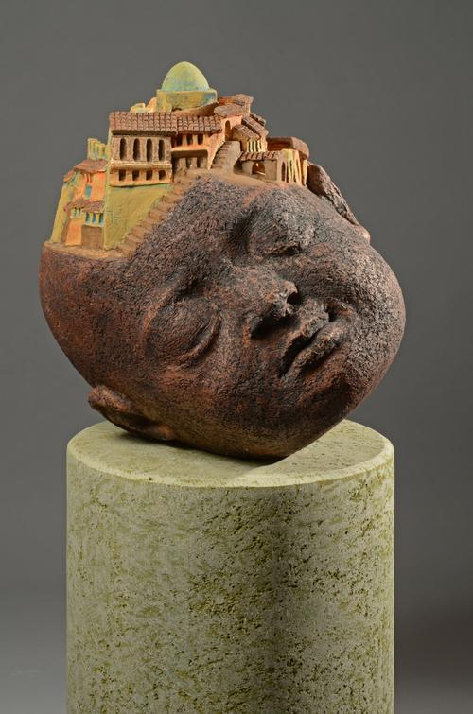

Slide 5
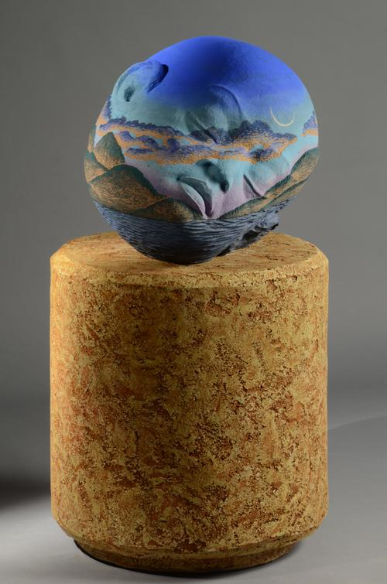

Slide 6
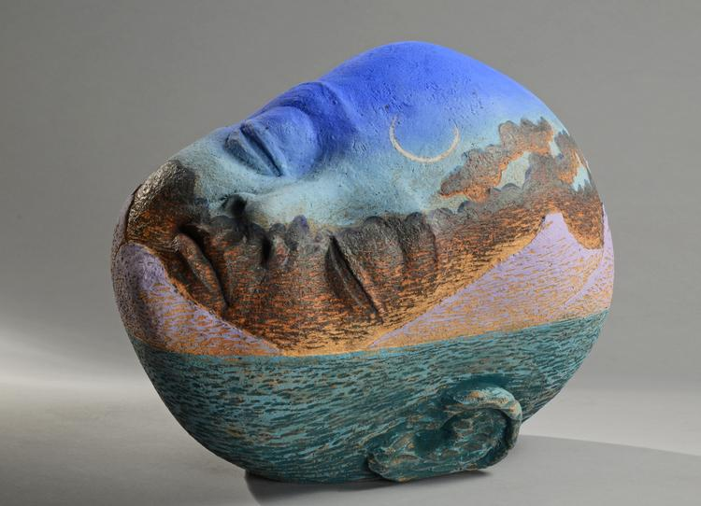

Slide 7
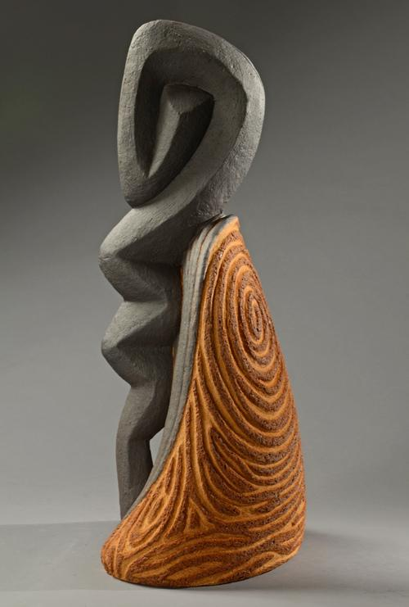

Slide 8
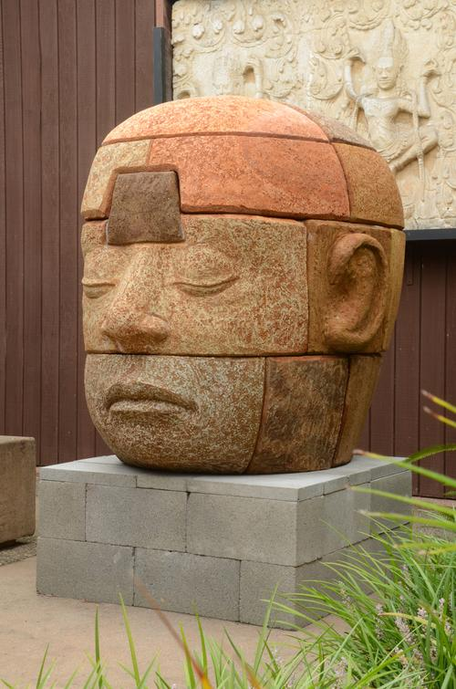

Slide 9
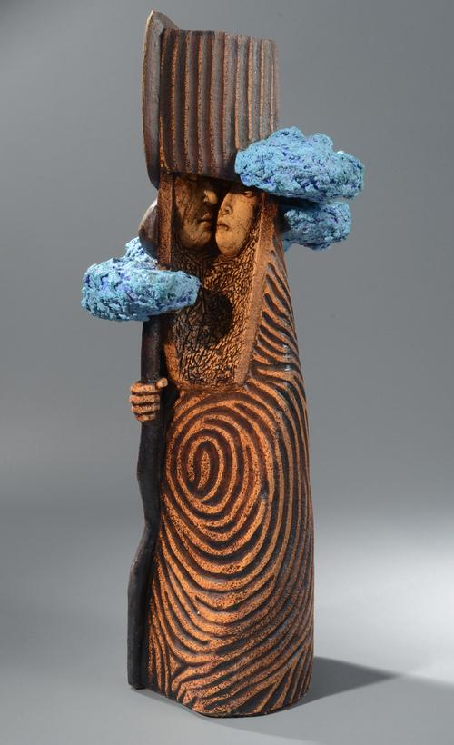

Slide 11
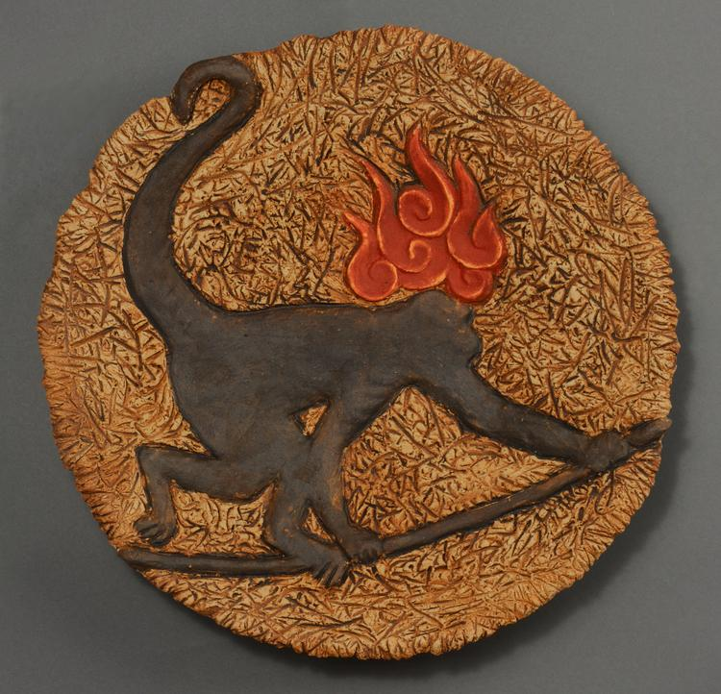

Slide 12
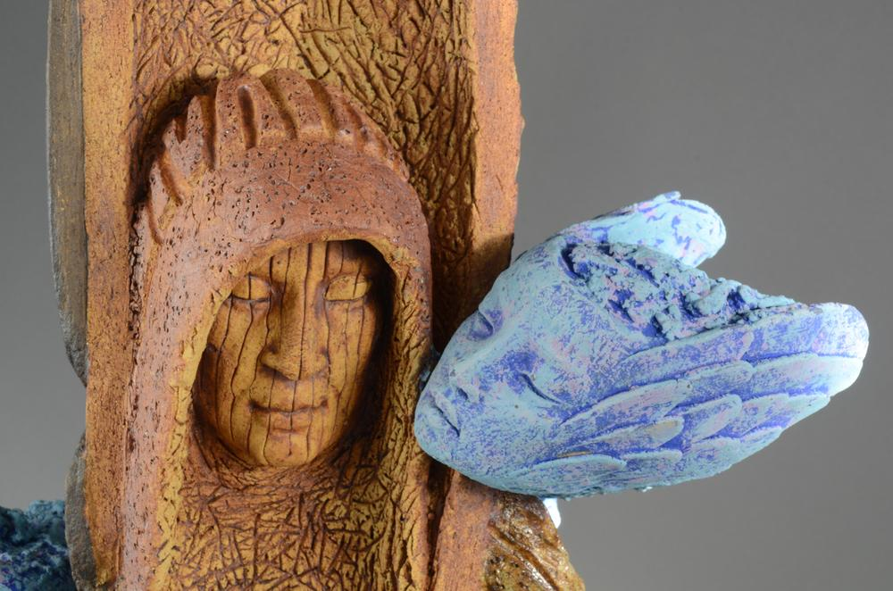

Slide 13
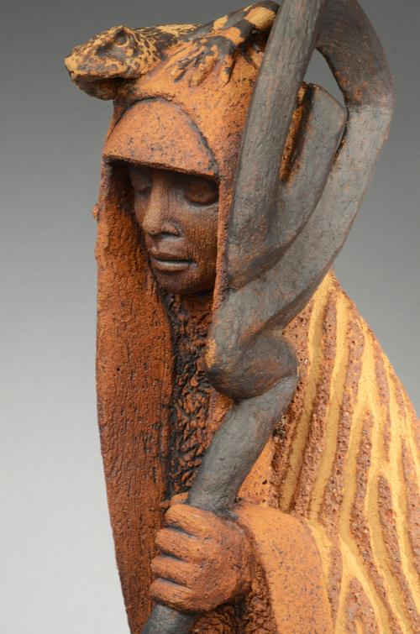

Slide 14
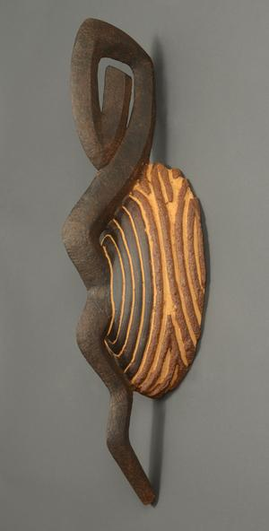

Slide 15
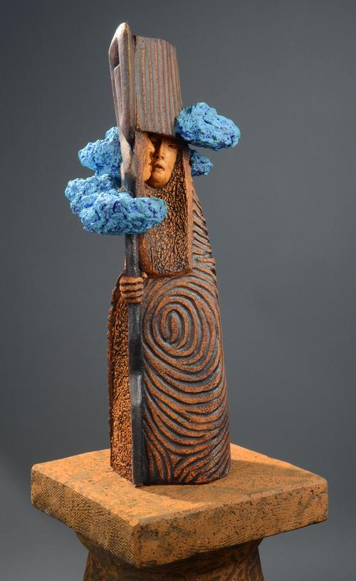

Slide 16
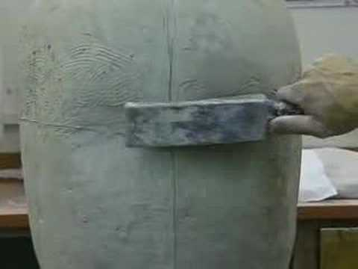

Slide 17
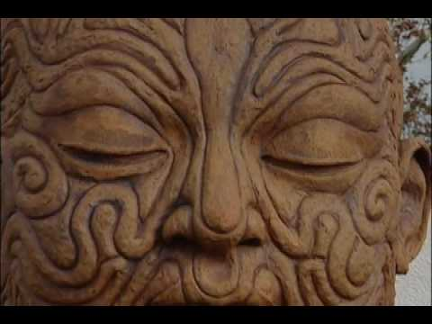

Slide 18
