Slide 1
Get out sculpture design and clay.

Slide 2
CCT

Slide 3
Clay Construction Techniques

Slide 4
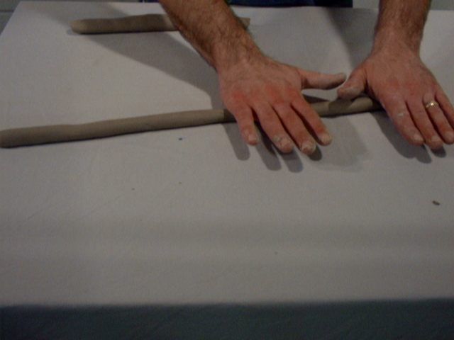
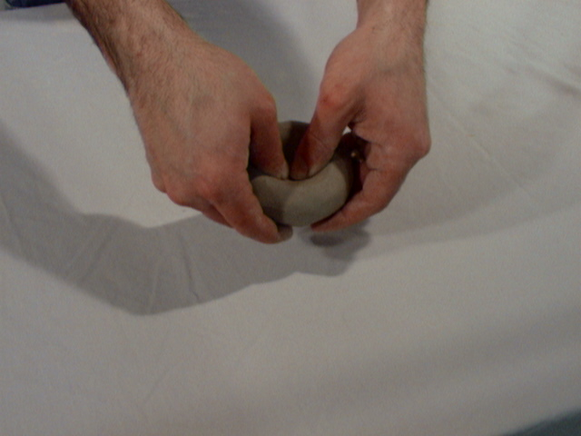
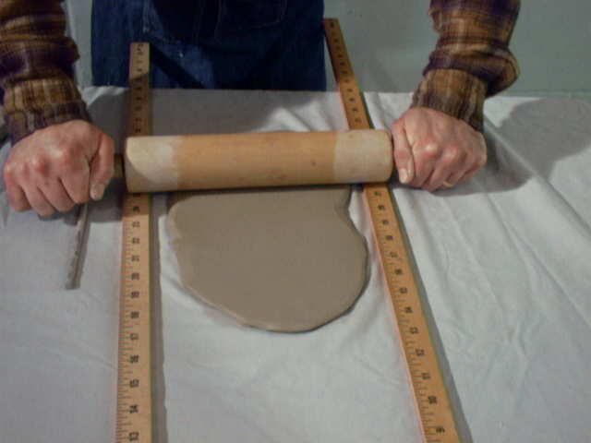
3 Clay Construction Techniques

Slide 5
3 Clay Construction Techniques
Coil
Pinch
Slab

Slide 6
To attach clay…
You do this

Slide 7
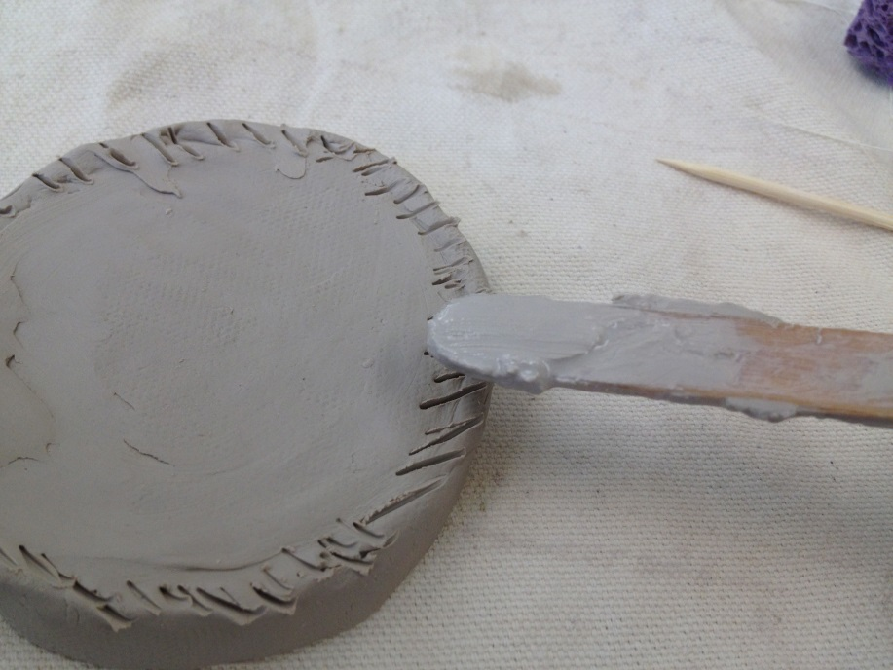
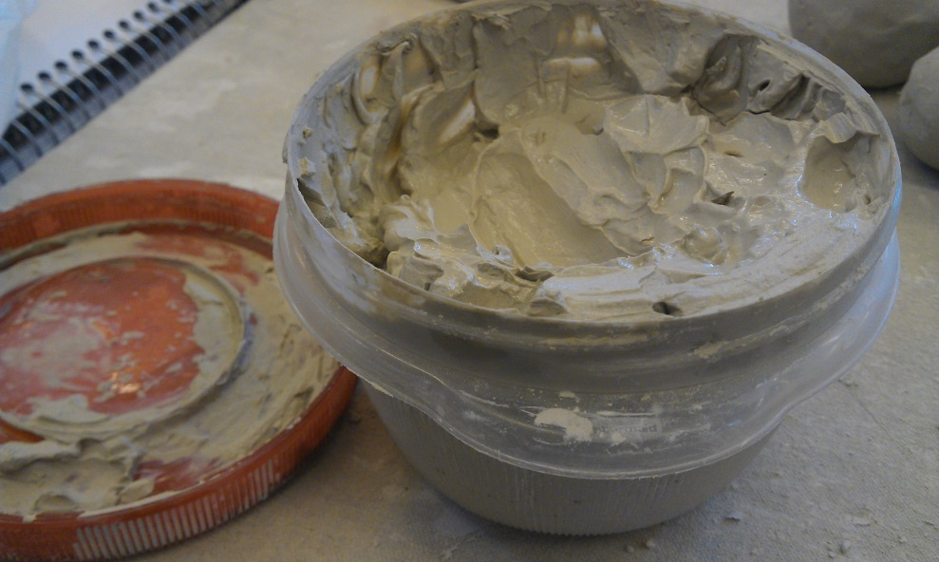
Score
&
Slip

Slide 8
Process of Clay
Plastic
.
Bone Dry
Fire in the Kiln
.
Fire in the kiln

Slide 9
Process of Clay
Plastic
Leather Hard
Bone Dry
Fire in the Kiln
Glaze
Fire in the kiln

Slide 10
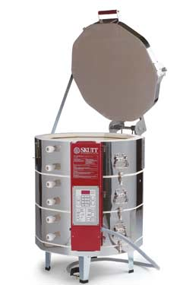
What is this?

Slide 11
Kiln

Slide 12
Procedures
Get slip ready
Apron?
Newspaper
Sketchbook Design (Has it been graded it?)
Pass test
Get clay (13oz)
Clay tools
Follow Clay rules!!!

