Slide 1
How to throw on the pottery wheel
Apron, water, sponge, clay
Wheel should spin __________________
Throw clay on wheel in the CENTER!
Make cone
Flatten top
CENTER- Right hand________ Left hand_________
Check to see if centered
When centered open middle with thumbs
STOP 1 inch from bottom
Pull up- Right hand__________ Left hand_________
Cut off and clean up

Slide 2
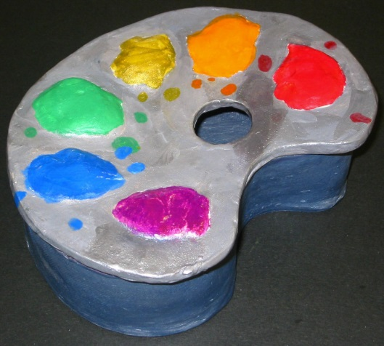
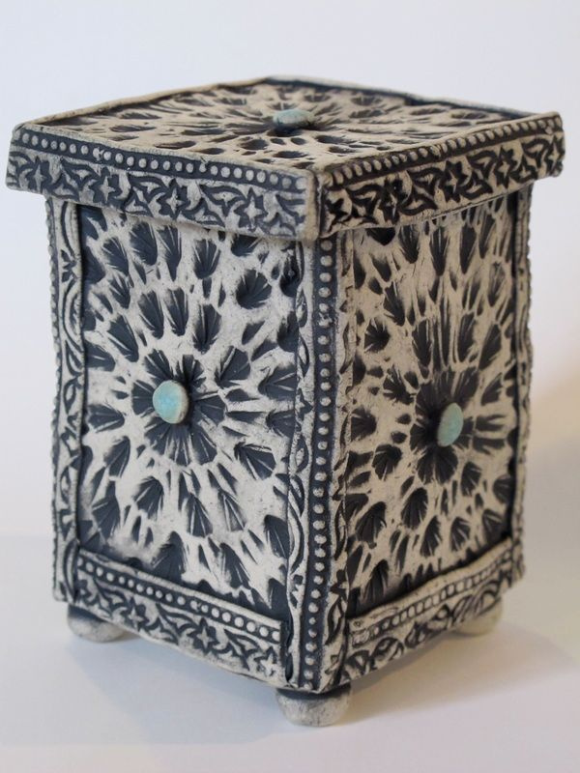
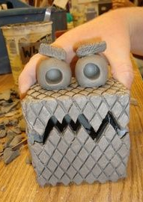
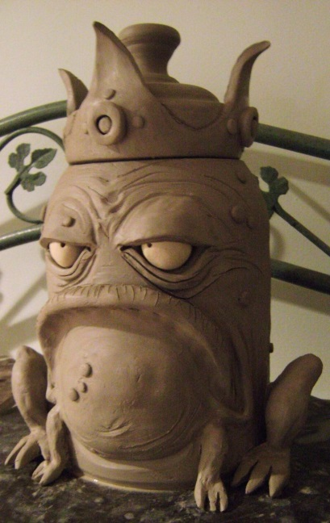
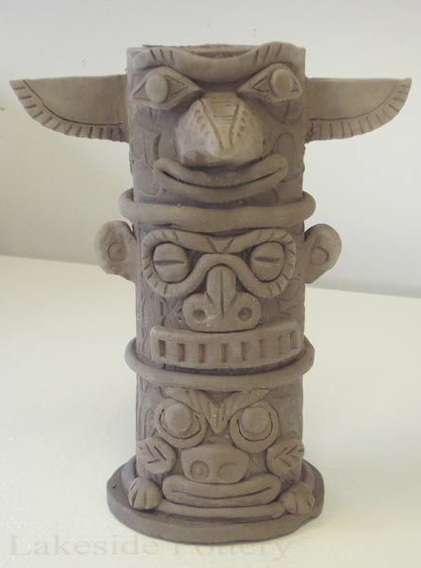
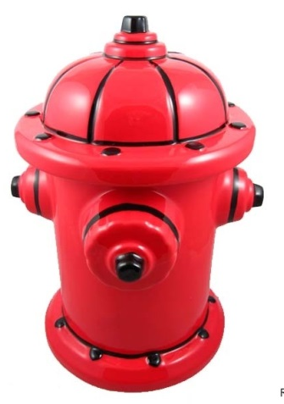
Hidden Container

Slide 3
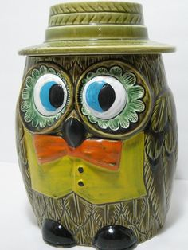
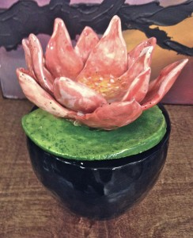
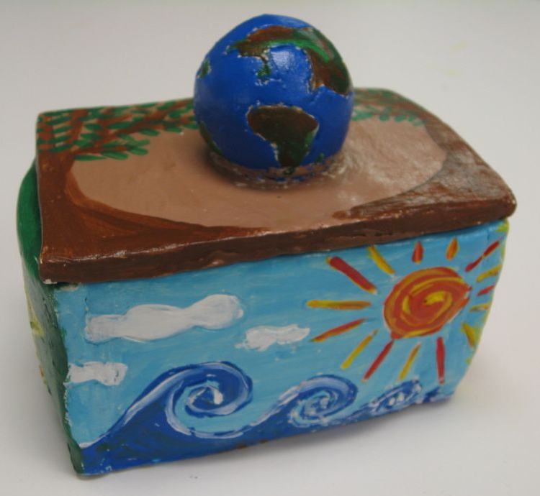
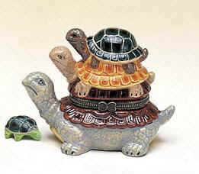
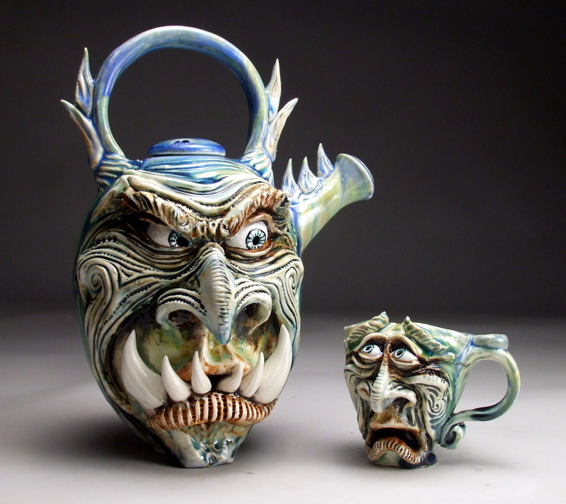
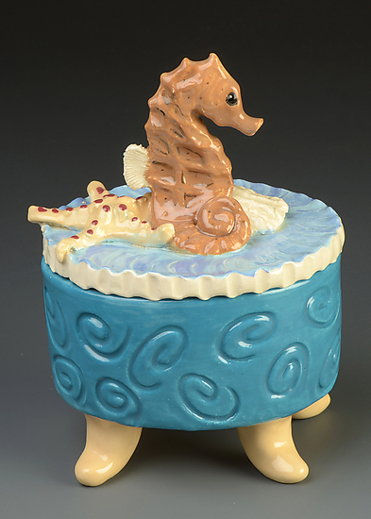
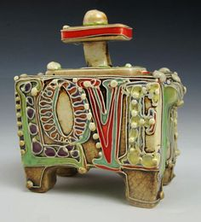

Slide 4
Rules
Architecture
Animal
Nature
Imagination
Vehicle
Pop Art
Nothing trademarked
Use at least 2 CCT
Around 5-6inches
Must have at least one lid
Pencil Thick
Score & Slip

Slide 5
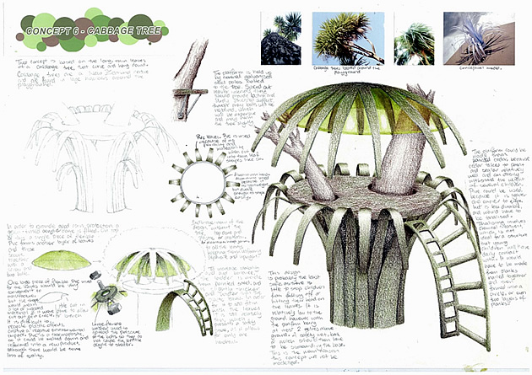
Design your sculpture
Sketch:
Front & Back view
Include influences
Fill the page
Label:
CCT
Size
Colors
Day 1:
Day 2:
Day 3:

