Slide 1
2 Point Perspective Tree House
HHS Art 1, November 2014

Slide 2
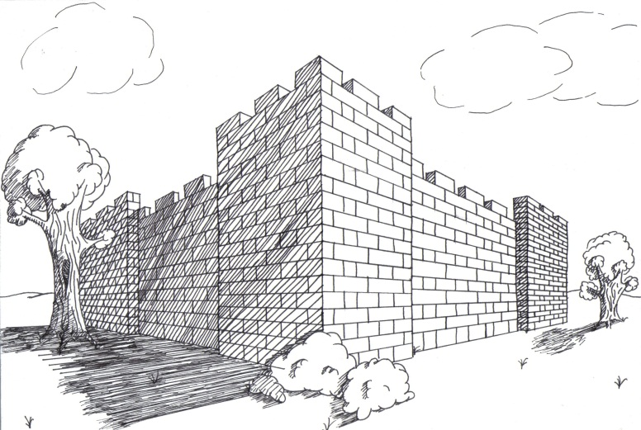
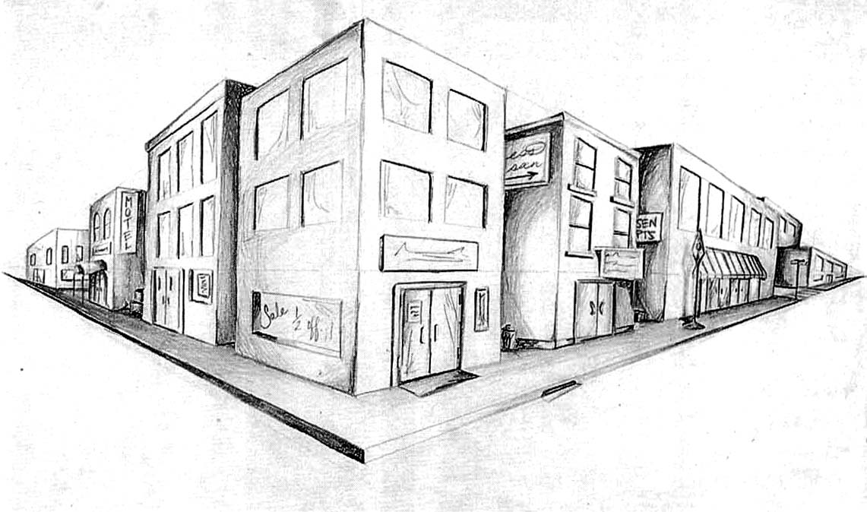
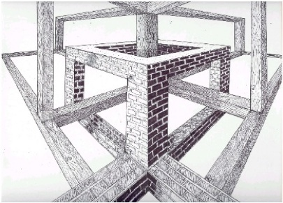
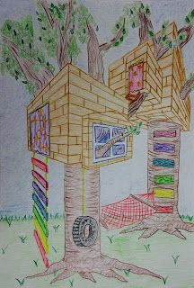
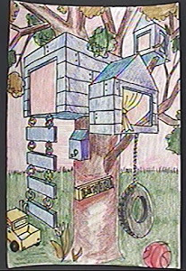
2 point perspective

Slide 3
Tree house requirements
Dominate the page
Have a theme (castle, pirates, space station, etc.)
Show two sides
At least two levels
Balcony or ledge that wraps around the house
At least 1 door and 3 windows
Ladder

Slide 4
What is your theme?
How are you going to get to the tree house?
What textures does it have?
What details match your theme?

Slide 5
Animal
Car
Culture
Fashion
History
Food
Hobby
Sports
Books
Shopping
Mythology
Fantasy
Movie
Cartoon
Architecture
Artist
City
Restaurant
Etc…
?

Slide 6
Perspective requirements:
Use 2-point perspective
All width/depth lines recede to appropriate vanishing points
Right-angled vertical sides should be drawn with parallel lines
All straight lines are drawn with a ruler/straight-edge

Slide 7
Draw Horizon line and 2 vanishing points far apart.

Slide 8
The corner of your tree house

Slide 9
Use both vanishing points!!!

Slide 10
2-Point Perspective Tree House
Tree house requirements
Dominate the page
Have a theme (castle, pirates, space station, etc.)
Show two sides
At least two levels
Balcony or ledge that wraps around the house
At least 1 door and 3 windows
Ladder
Perspective requirements:
Use 2-point perspective
All width/depth lines recede to appropriate vanishing points
Right-angled vertical sides should be drawn with parallel lines
All straight lines are drawn with a ruler/straight-edge
Add a tree/ trees!

